Slide 1
YOUTH & COMMUNITY EMPOWERMENT (NATIONAL COUNCIL)
WOMEN´S INDIAN CHAMBER OF COMMERCE AND INDUSTRY
www.wicci.in

Slide 2
Our Mission & Vision
As an Youth & being a responsible citizen of India, I feel that each one of us has a share of responsibility to develop our country's social, economical, mental-health, cultural and overall community.
Our primary vision is to make our country a better place to live where equal rights, facilities, pay scale is given to each youth especially ladies where they have the freedom to express their thoughts, showcase their hidden skills & talent which should/must be recognized by the entire community.
Our mission is to prepare the young people to achieve positions of power they deserve be it by helping them in person or encouraging them mentally.
Here are some of the aims/objectives on which we would like to put special focus on:
1. To engage youth in exploring career possibilities based on their interests.
2. To guide youth in analyzing and addressing their community concerns
3. To engage youth in exploring their culture & ethnicity.
4. To engage youth in exploring ways of building strong relationships at various levels of society.
5. To build the capacity of organizations to support the communities they serve.
The above aims/objectives will focus on boosting awareness among the youth & entire community. And as we are gradually moving ahead towards digital India, we would like to conduct various sessions both Online as well as offline in spreading mass awareness. We can organize workshops, programs, sessions, panel discussions etc. under the supervision & guidance of WICCI to raise awareness about Youth & Community Development keeping in note the above aims/objectives.
I hope & wish that WICCI will definitely play a great role in accomplishing our mission & vision for a new & better India where the Youth & Community is established, unshackled, vigorous and above all empowered!!!
Moumita Chakraborty,
National President,
Youth & Community Empowerment Council - WICCI

Slide 3
Welcoming
Council Members to
WICCI
NATIONAL COUNCIL
YOUTH & COMMUNITY EMPOWERMENT
(WICCI)
Youth & Community Empowerment - National Council

Slide 4
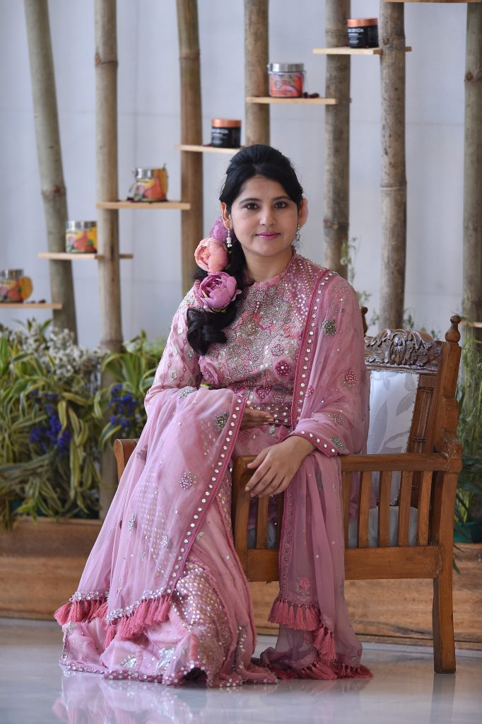
Dr. Harbeen Arora, Founder & National President - WICCI Founder President (WOMEN’S INDIAN CHAMBER OF COMMERCE & INDUSTRY) WICCI
Dr. Harbeen Arora Rai, is the Founder President of Women's Indian Chamber of Commerce and Industry (WICCI) | G 100 | ALL Ladies League (ALL) | Women Economic Forum (WEF) | SHEconomy | BIOAYURVEDA | Chancellor, Rai University, India.
She is recognized Among 100 Most Reputable People on Earth (Reputation Poll 2019) India.
She is a Thought Leader, Global Icon & Visionary for Women, Businesswoman, Philanthropist Author, Humanitarian, Spiritual Seeker and Compelling Speaker, Dr. Harbeen Arora Rai manifests multifaceted leadership with strength & simplicity.

Slide 5
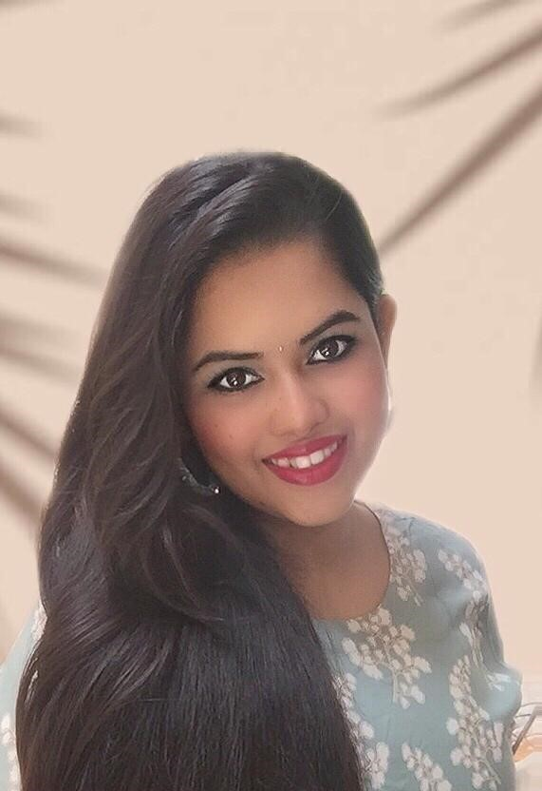
Moumita Chakraborty, National President National President (YOUTH & COMMUNITY EMPOWERMENT COUNCIL) WICCI
Ms. Moumita Chakraborty, MTTM, is an Indian Entrepreneur, Founder & CEO of Destinatia Tours & Travels, Humanitarian, Travel vlogger, YouTuber, Mental Health speaker, Political observer, passionate singer, photographer and a great follower of Maa Saraswati, freedom fighter Netaji Subhas Chandra Bose & Business Tycoon Shri. Ratan Tata. She has been felicitated with the “Young Achiever of the Year 2022” Award at India’s Most Trusted Brand of the Year 2022, held in New Delhi on 30th April 2022, National Business Leadership Award 2019 for Destinatia Tours & Travels. She has also been felicitated with many honorees since her academic days till date. She has done sessions on different important topics with personalities of National repute like Major Gen. G.D. Bakshi (Rted. Indian Army Officer, Author, Public Speaker), Shri. Chandra Kumar Bose (Great Grandson of Netaji Subhas Chandra Bose, Political Leader), Shri. Anuj Dhar (Author, Public Speaker), Shri. Niladri Banerjee (Political analyst & speaker), Shri. Nijo jonson (Youtuber, Director, Filmmaker), Dr. Mrinal K Debnath (Psychaictrist, Filmmaker, Political Leader), Shri. Abhijit Roy (Great Grandson of Netaji Subhas Bose, Public speaker) and many more in the list to be added… Talking about Destinatia, Chakraborty says, “It is my dream to see Destinatia as the best Travel Company in not only Northeast India, but globally by providing best travel services to each & every guest of ours.” She also has experience in the field of Education sector where she worked as a Guest Lecturer in different colleges. She has also worked in giant companies like Air India Ltd. & Balmer before starting up her own firm. She has a keen interest in working on sectors related to Youth employment, community development, Aviation, Travel & Tourism, Entrepreneurship, Education, Handloom & Handicraft sectors in India for which she is taking leap of steps forward and has a mindset to take a quantum leap for YOUTH & COMMUNITY EMPOWERMENT in India & globally.

Slide 6
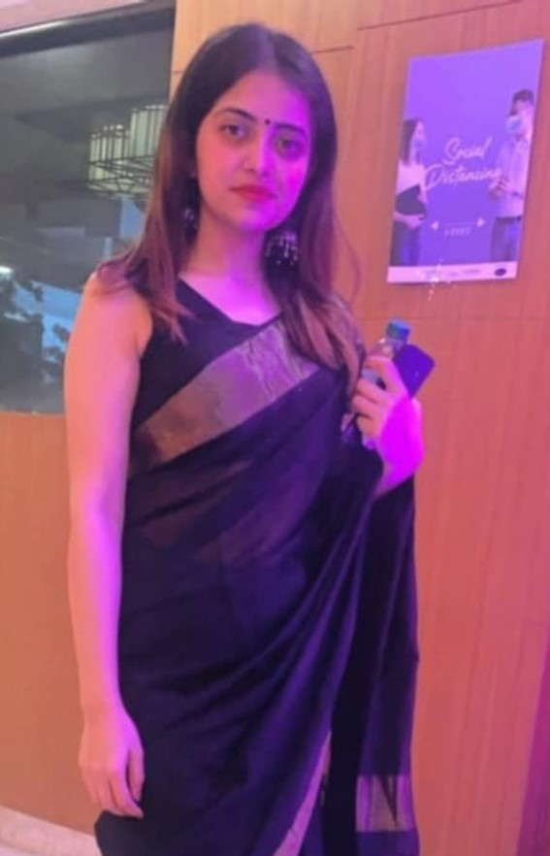
Akarshika Sharma, State President (Delhi) State President - Delhi (YOUTH & COMMUNITY EMPOWERMENT COUNCIL) WICCI
BIO:-Ms. Akarshika is a Cabin Crew at Vistara - TATA Sia. She has done her graduation in political science (Hons.) and have done her Post Graduation in Business Administration. She is also a kathak dancer and have been working as a cabin crew since 2018 with TATA SIA . She has participated in various ssessions related to social welfare and hosted various online panel discussions. She has a drive to do something better for the society.

Slide 7
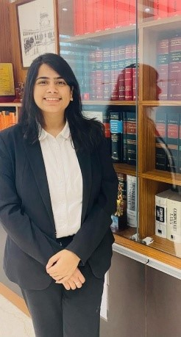
Jagriti Dosi, State Vice - President (Delhi) State Vice President - Delhi (YOUTH & COMMUNITY EMPOWERMENT COUNCIL) WICCI
BIO:- Jagriti Dosi , a law graduate from Guwahati and having the dream of making her name in the legal field, handles the Corporate practice of the chambers of Abhinav Mishra, Advocates & Solicitor, in Delhi. She possess knowledge in the field of Corporate, Commercial and Arbitration laws and trying to create the minutest change possible by her contribution in the availability of lawyers working for the poor and society.

Slide 8
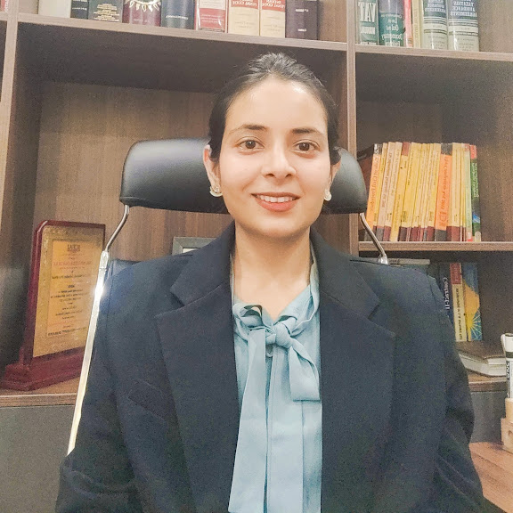
Nivedita Chauhan, State President (Madhya Pradesh) State President – Madhya Pradesh (YOUTH & COMMUNITY EMPOWERMENT COUNCIL) WICCI
BIO:- Advocate by profession and the Co- Founder/Partner at the Chambers of Abhinav Mishra, Advocates and Solicitors, Hon’ble Supreme Court of India.
Her Practice areas are in Corporate Litigation & Advisory, Arbitration, Real Estate Laws, Writ Petitions, White Color Crimes and Intellectual Property Laws. Right from being a Legal Advisor to the Embassy of Islamic Republic of Afghanistan in New Delhi to being a counsel to Multinational/ Leading Real Estate/ Construction Corporations/ Asset Reconstruction brands/ Start- ups/Media Company (Companies like Sunflag Iron & Steel Co. Ltd, Winsome Breweries Ltd. to name a few).
Besides advocacy, she takes immense pleasure in contributing to the society by creating awareness on social and human rights issues by conducting legal awareness camps in remote areas of the country as well as in contributing to the promotion and development of clinical legal education by organising National Level Moot Court competitions.
She has also delivered lecture on various topics of law on various online forums as a part of my contribution to the legal education.

Slide 9
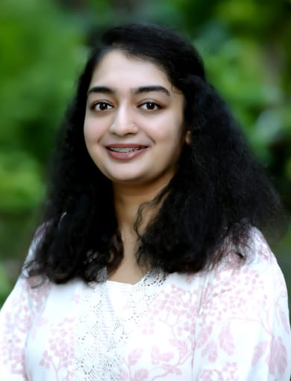
Shalini Kapoor, State Vice - President (Madhya Pradesh) State Vice President – Madhya Pradesh (YOUTH & COMMUNITY EMPOWERMENT COUNCIL) WICCI
BIO:- She is the consultant at Atma (an NGO Capacity Building organisation) and has close to 4 years of experience in the impact sector.
Her experience and learning from being a teaching Fellow & spearheading the implementation of education programs with state governments and communities directly provided her with the foundation for building meaningful relationships, non-profit management, fundraising, and hands-on experience in managing and coordinating multi-stakeholder projects that create holistic ecosystems.
She has also been selected as a GGI Fellow in 2022 and is deeply passionate about creating a positive social Impact.
She is a certified PADI open water Scuba diver and loves to explore the ocean.

Slide 10
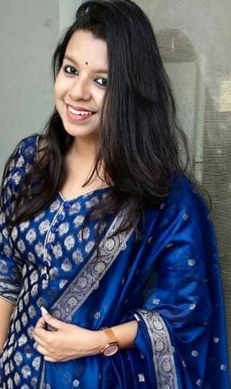
Sivayeeka Sivani, State Council Member (Odisha) State Council Member - Odisha (YOUTH & COMMUNITY EMPOWERMENT COUNCIL) WICCI
BIO:- Sivayeeka Sivani holds an M.Phil degree in English literature from Ravenshaw University, Odisha. She works at Byju's, the largest ed-tech company of India. She also works as a volunteer in Charmaghz, a mobile library for children in Afghanistan. Prior to this, she has worked at central and state government colleges and NGOs. She has been published in peer-reviewed journals for her research on Afghanistan women autobiographies. She is mainly engaged in academic qualitative research on gender, equality, intersectionality, gender-based violence, educational and social upliftment.

Slide 11
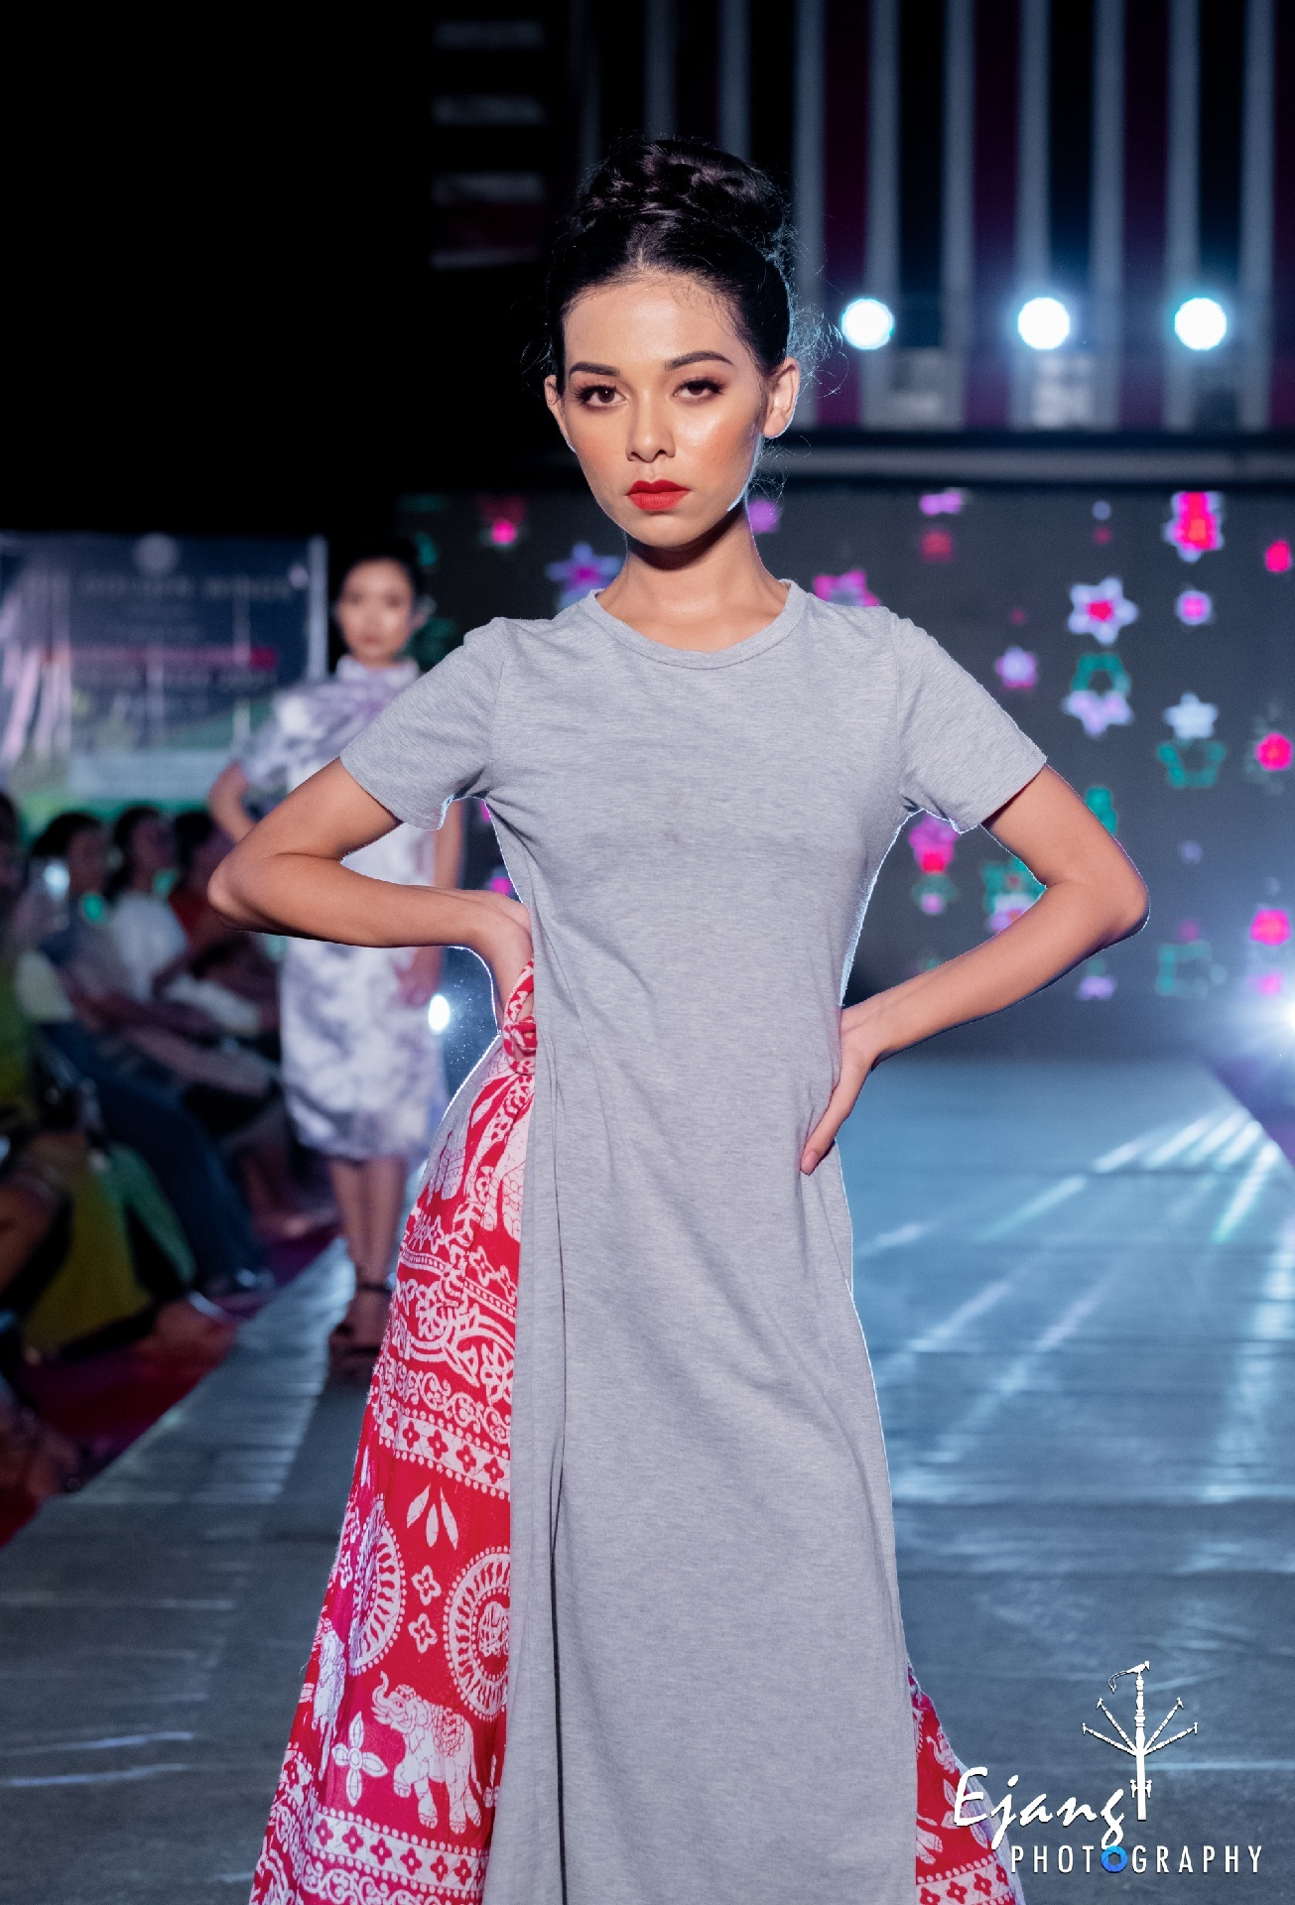
Himani D Hasnu, National Council Member National Council Member (YOUTH & COMMUNITY EMPOWERMENT COUNCIL) WICCI
BIO:- Himani Das Hasnu from Assam is an entrepreneur, a model & a student. She has always loved to explore and volunteer herself to whatever comes to her hand be it helping youths and empowering women in any ways she can. Being crowned as Miss Fashion Icon 2020 and soon going for Miss Gran Glam India 2022, she keeps her walk to empower women and youth to follow what their heart speaks. She has keen interests in poetry, Sports like Hockey, Khokho and Basketball.”

Slide 12
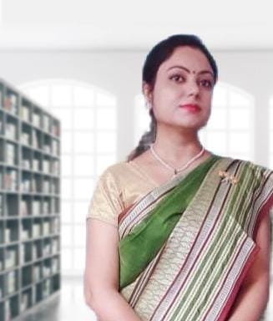
Protusha Mukherjee, National Council Member National Council Member (YOUTH & COMMUNITY EMPOWERMENT COUNCIL) WICCI
BIO:- Ms. Protusha Mukherjee is an enthusiastic & energetic English teacher with 3+ years’ experience managing a large and diverse students. She has been awarded Distinction in B.Ed.. She has participated and presented paper entitled “Empowerment of Woman and Weaker Sections “in one day National Seminar on Poverty, Inequality, Exclusion & Inclusive Education: Problems and Solutions organized by Department of Education, RSP College, Dhanbad. She has attended seminars of DAV groups based on training programmes for the quality development of teaching skills. Ans also participated in National Youth dialogue on “Emerging social, economic, political, cultural and environmental issues in India” organised by Human empowerment & research society, Varanasi.

Slide 13
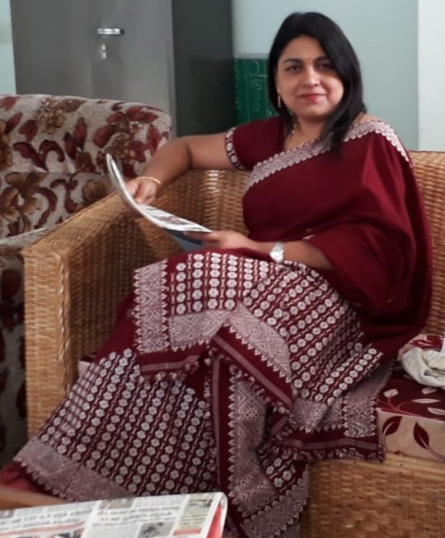
Anjalee Devi Hazarika, State President (Assam) State President - Assam (YOUTH & COMMUNITY EMPOWERMENT COUNCIL) WICCI
BIO:-Mrs. Anjalee Devi Hazarika is Teacher of Maharishi vidya Mandir IV, Lalmati Guwahati, Assam. She is a respectable lady with experience of providing education to students and enthusiastic to be a part of a team which works for the betterment of the society.

Slide 14
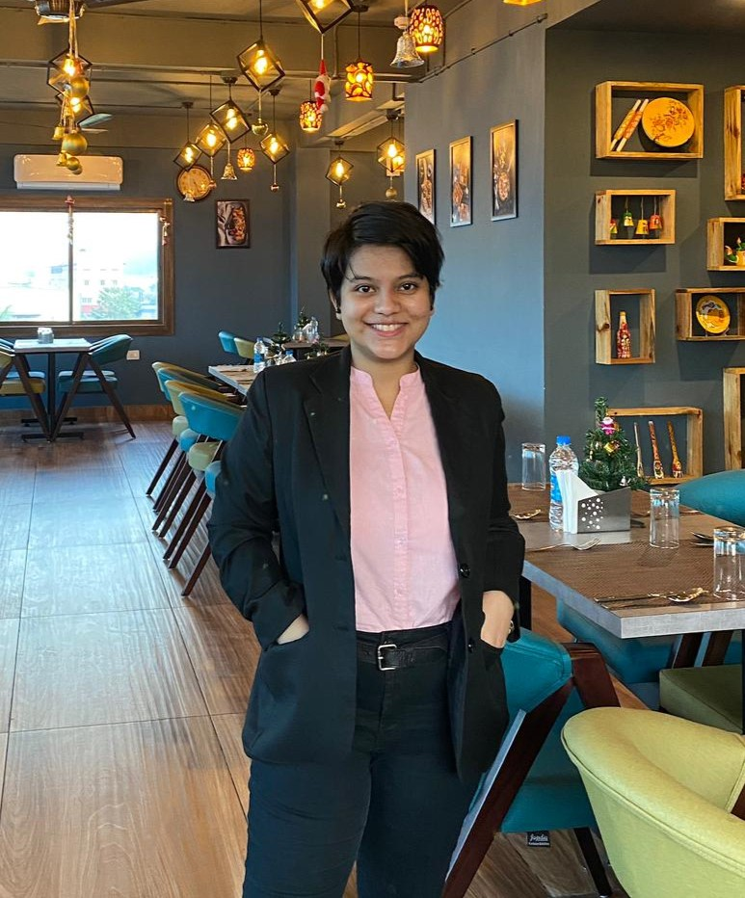
Nidhi Medhi, National Council Member National Council Member (YOUTH & COMMUNITY EMPOWERMENT COUNCIL) WICCI
BIO:- Nidhi Medhi is an enthusiastic, smart young lady, a leading student who displays strong work passion and good creative ability. In her words about WICCI “Aiming to use my creative and hard working skills as a member in your organisation. Will make use of interpersonal skills to reach more people and expand its outreach.”

Slide 15
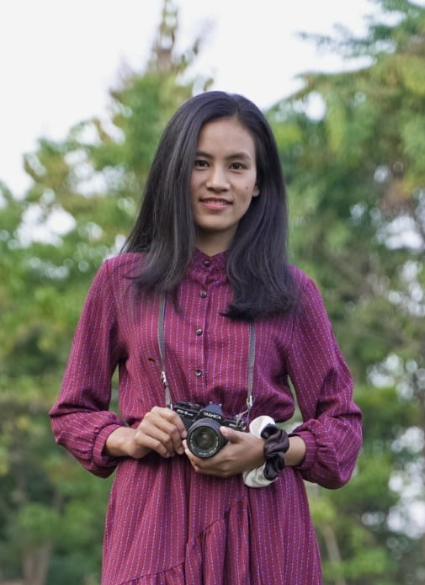
Nlum Peule, National Council Member National Council Member (YOUTH & COMMUNITY EMPOWERMENT COUNCIL) WICCI
BIO:- Ms. Nlum Peule, from Nagaland is a graduate pursuing PG in MSW from Mizoram University. Her hobbies include playing badminton to keep herself physically active, travelling cause she has exploring new places, making new friends, and reading. Aims - my aim is to be a successful social worker.

Slide 16
Anamika Dutta, National Council Member National Council Member (YOUTH & COMMUNITY EMPOWERMENT COUNCIL) WICCI
BIO:-Anamika Dutta is a senior journalist, anchor, model, currently working as a Sr. Ingest Executive (Technical) in a news channel ND24. She describes herself as “A hard working self independent women from a small town,believe in positivity, I believe if it is not today then it will be definitely tommorow. simple living high thinking.

Slide 17
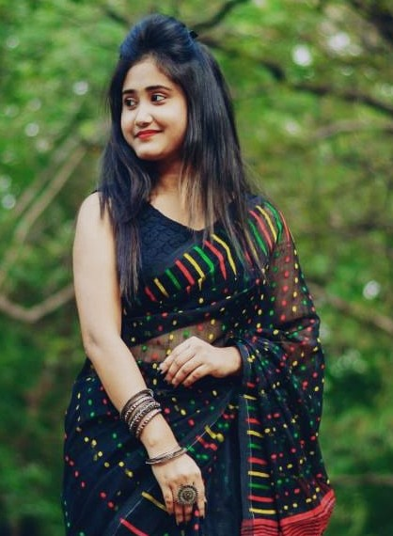
Mouli Samanta, National Council Member National Council Member (YOUTH & COMMUNITY EMPOWERMENT COUNCIL) WICCI
BIO:- Ms. Mouli Samanta, hails from the city of Durgapur, West Bengal. She is a working professional with over 5 years of work experience in various wellknown organisations like Narayana Health, Uber, SBI. Her hobbies include singing, modeling, dancing & drawing. She has won various certificates in dancing & drawing too. She has excellent communication skills and has a empathic nature for which she is glad to be a part of YCEC and help people around her.

Slide 18
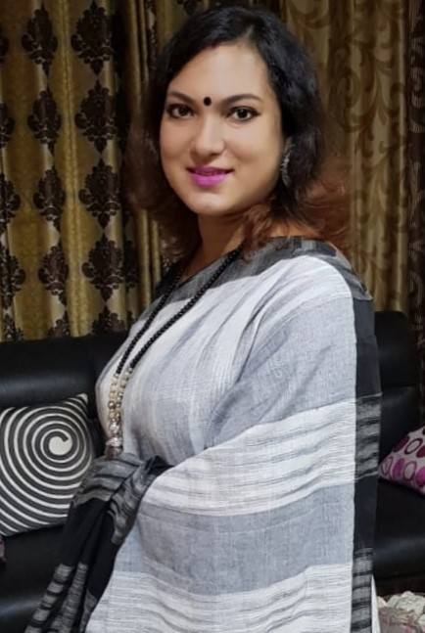
Riya Banerjee, National Council Member National Council Member (YOUTH & COMMUNITY EMPOWERMENT COUNCIL) WICCI
BIO:- Riya Banerjee is a Tourism, food & catering industry professional with an industrial exposure of more than 7 years. Her career objective is to be a renowned professional in tourism industry, being an outstanding performer by constant learning with discipline, hardwork, innovation, confidence & dedication towards responsibilities.

Slide 19
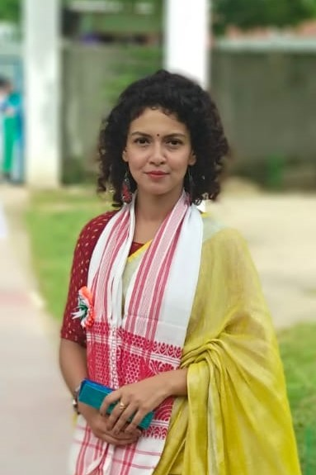
Sudipta Sharma, National Council Member National Council Member (YOUTH & COMMUNITY EMPOWERMENT COUNCIL) WICCI
BIO:- Sudipta Sharma, is a High School Mathematics teacher under Secondary Education, Govt of Assam. She was an Ex Care taker Officer of NCC at MHSS. She is very much interested in animal & social welfare services. Her area of interests include art, poetry, quotes, nature, travelling, photography & learning new skills.

Slide 20
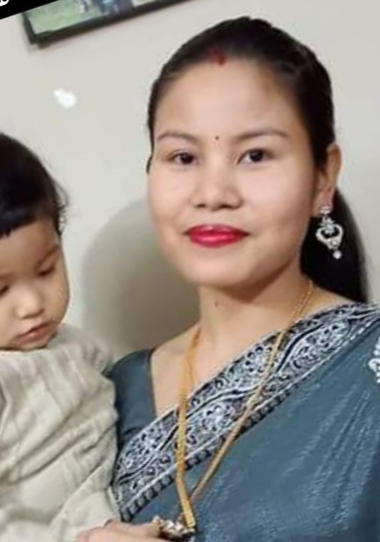
Briti Daulaguphu Thousen, National Council Member National Council Member (YOUTH & COMMUNITY EMPOWERMENT COUNCIL) WICCI
BIO:- Mrs. Briti D Thousen is an active, social and a jubilant woman. She has an industry experience of about 7 + years as a Quality Supervisor in a F&B firm in Sonapur, Assam. She has always been pro-active about taking risks in life and is now happy Mom of a 3 year old daughter. She has interests in handloom, weaving and uplifting the youth & community for a betterment of the society.

Slide 21
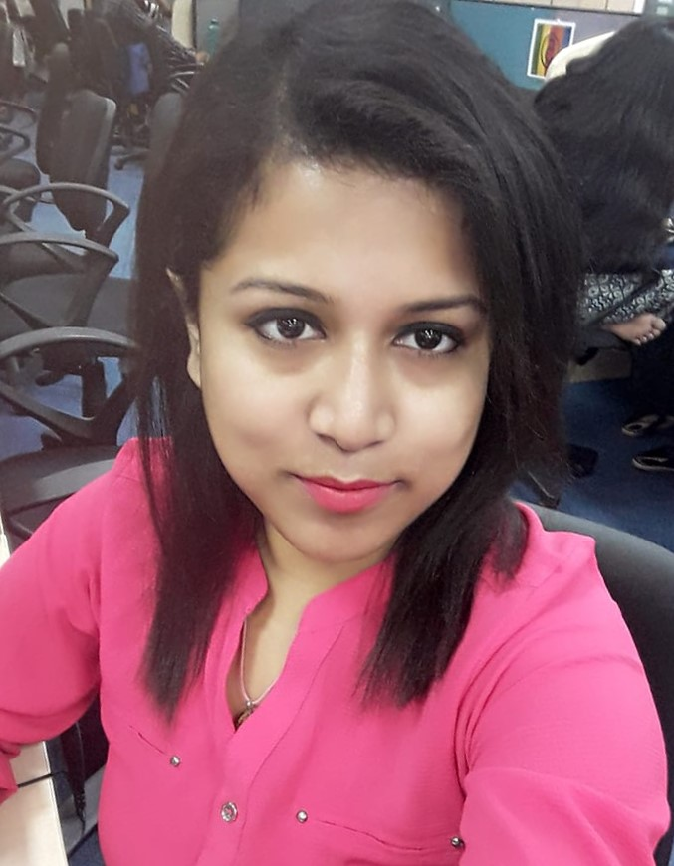
Sonia Mukherjee, National Council Member National Council Member (YOUTH & COMMUNITY EMPOWERMENT COUNCIL) WICCI
BIO:- Ms. Mukherjee is working in a corporate sector as a senior business consultant where she has an experience of around 9 years in sales & marketing. She is currently working as a Senior Sales Advisor in JustDial Ltd. In her own words “I love travelling, exploring new places and gather new experiences. Also I am connected with a NGO named "ichhe Dana" as bcz I love to do some activities to help needy people.” She is a well-spoken, smart & active lady.

Slide 22
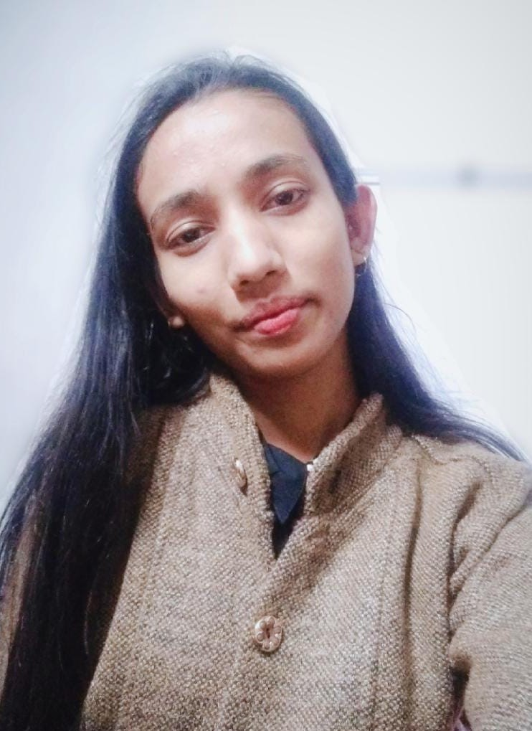
Nilofar Rahman, National Council Member National Council Member (YOUTH & COMMUNITY EMPOWERMENT COUNCIL) WICCI
BIO:- Ms. Nilofar Rahman, is a student currently pursuing her bachelors in dental surgery (BDS). She has good speaking skills, she has delivered speeches on many social awareness events. She has participated in debate competitions at regional levels and was selected for the nationals too. She loves being around nature, learning new things and doing things perfectly. She has deep pursuit in singing, poetry and quotes. She has interest in psychology, human behaviour, literature and philosophy. Apart from all these, she loves to work for the society and for youth and women empowerment. And is proud to be a part of WICCI.

Slide 23
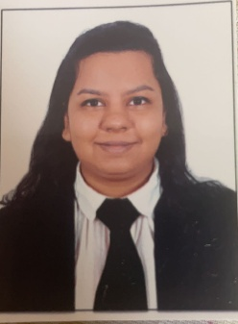
Anisha Mimani, Council Member State Council Member - Delhi (YOUTH & COMMUNITY EMPOWERMENT COUNCIL) WICCI
BIO:- Anisha Mimani is an Advocate by profession. She has practised it for a year, but now she is venturing into her own business. She is a commerce graduate from the esteemed Delhi University. She was a part of the Social Welfare Ministry in her school where they conducted various drives; from collecting clothes for orphanages to holdings seminars on social welfare, etc. She describes herself as “zealous about doing something concrete for society and uplifting the lives of many.”

Slide 24
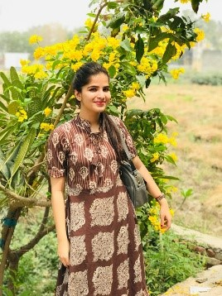
Pooja Joshi, Council Member State Council Member - Delhi (YOUTH & COMMUNITY EMPOWERMENT COUNCIL) WICCI
BIO:- Pooja Joshi is an HR professional with approximately 5+ years of experience, managing a full spectrum of human resources programs, services and functions, supporting a broad range of employment areas and managing team for end to end recruitment for permanent and contract position for product and service client.

Slide 25
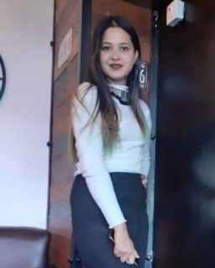
Divya Chauhan, Council Member State Council Member - Delhi (YOUTH & COMMUNITY EMPOWERMENT COUNCIL) WICCI
BIO:- Divya Chauhan is currently pursuing Material Management from College of Vocational Studies, Delhi University. She is the Media Coordinator at Jaunsar Bawar Student's Association. She is also active on the core committee of Manthan the Fashion Society of CVS.

Slide 26
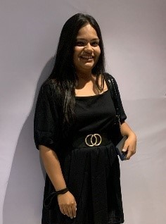
Sindhuja Sharma, Council Member State Council Member - Delhi (YOUTH & COMMUNITY EMPOWERMENT COUNCIL) WICCI
BIO:- Sindhuja Sharma has recently completed her Bachelor's degree in Commerce from Delhi University where she was appointed as the Vice President of the Environment Club of CVS. She was also on the advisory board of Enactus CVS and the Marketing Society of CVS. Apart from this, she has worked as an intern in various fields such as HR, Marketing, Social entrepreneurship and Social media handling. She is also interested in the impact sector which led me to work on a very special project that focuses on uplifting the handloom community as well as upcycling single-use plastic.

Slide 27
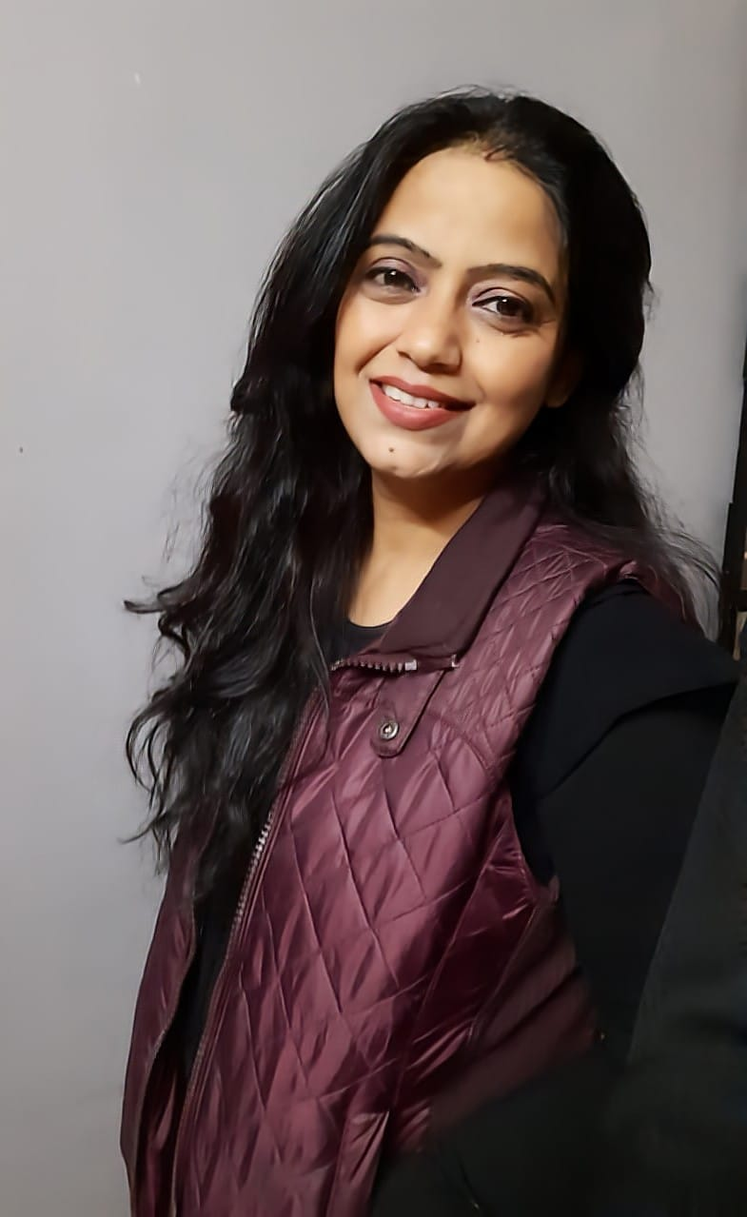
Ambika Shrivastava, Council Member State Council Member – Madhya Pradesh (YOUTH & COMMUNITY EMPOWERMENT COUNCIL) WICCI
BIO:- IT Head, CCIT at Career Computer Institute of Information Technology, Chhatarpur, M.P.
She has 17 years of experience in teaching and building application & Softwares. She is skilled in creating websites using CSS, HTML, JAVA Script. She continues to explore the field of website development.
For her being a successful woman in business means having the courage to own who you are, why you are doing what you do and how you can apply your vision to positively impact the world.

Slide 28
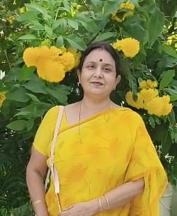
Taruna Chauhan, Council Member State Council Member – Madhya Pradesh (YOUTH & COMMUNITY EMPOWERMENT COUNCIL) WICCI
BIO:- She is a Psychologist and specialized in mental retardation from Dr. Hari Singh Gour Universisty, Sagar, Madhya Pradesh. She is also a Partner in the CNITS Developers and Colonizers, which is a Real Estate firm based in Chattarpur, Madhya Pradesh. She owns many more businesses of farming and stone & sand mining.

Slide 29
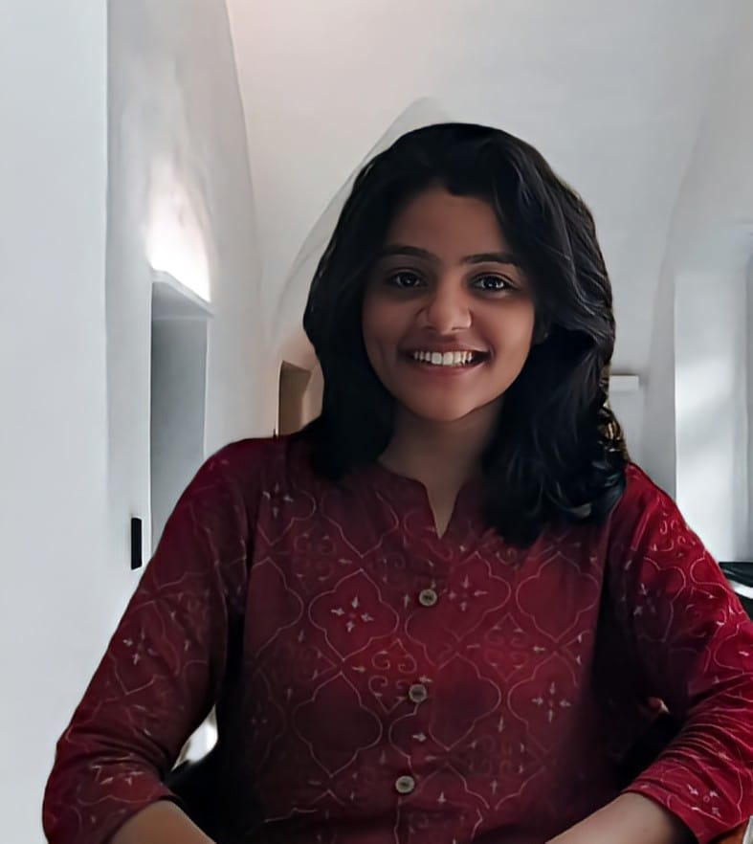
Shubhika Singhal, Council Member State Council Member – Madhya Pradesh (YOUTH & COMMUNITY EMPOWERMENT COUNCIL) WICCI
BIO:- She is currently in her 5th year of pursuing Bachelor's in Architecture. She is also interning with reputed firm to gain work experience. She believes that real empowerment of women lies in the freedom to choose their ambitions, to have equal rights to education and finances.

Slide 30
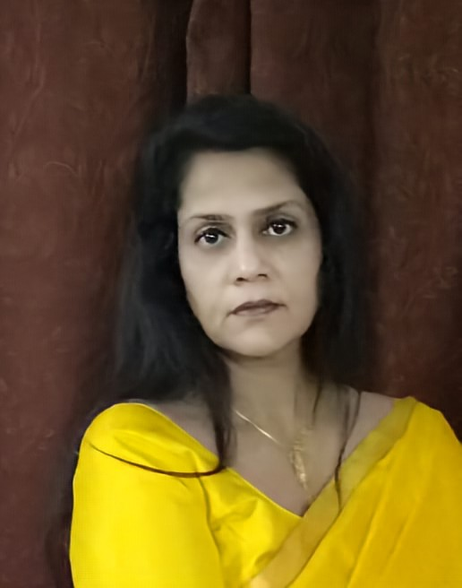
Dr. Kirti Singh, State Council Member State Council Member – Madhya Pradesh (YOUTH & COMMUNITY EMPOWERMENT COUNCIL) WICCI
BIO:- Gynaecologist (Independent Medical Practitioner). She is an MBBS and has an MS in Obst. & Gynae.
Her idea of Women empowerment means Physical, Mental, Social , Financial, Independence with equal devotion to family & its values.

Slide 31
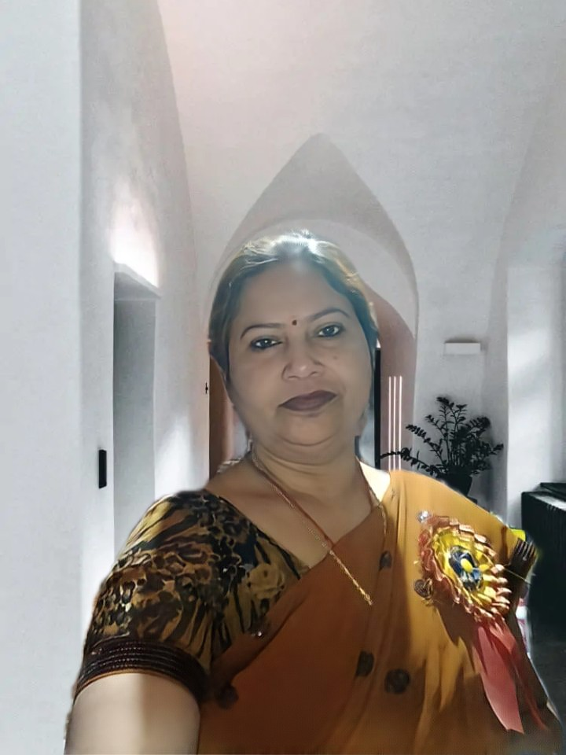
Meenu Agrawal, Council Member State Council Member – Madhya Pradesh (YOUTH & COMMUNITY EMPOWERMENT COUNCIL) WICCI
BIO:- Meenu Agrawal is President of Sankalp Foundation, a Non- Government Organisation and is based out of Nowgong, Distt. Chhatarpur, Madhya Pradesh. She is involved directly and indirectly with various social welfare organization and is actively involved in feeding and taking care of stray animals.

Slide 32
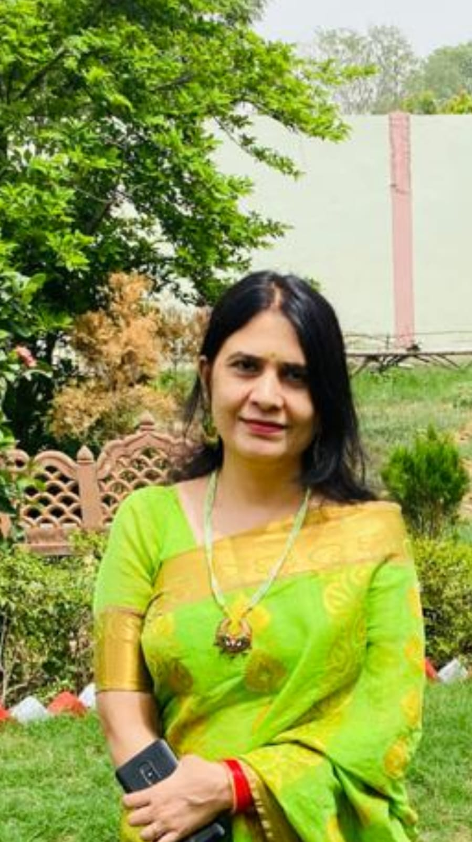
Shraddha Chauhan, Council Member State Council Member – Madhya Pradesh (YOUTH & COMMUNITY EMPOWERMENT COUNCIL) WICCI
BIO:- President of the NGO, Matra Shakti Sangathan. Her NGO caters to various social issues and works across various thematic areas such as Agriculture, Art & Culture, Differently Abled, Disaster Management, Drinking Water, Education & Literacy, Aged/Elderly, Environment & Forests, Human Rights, Women's Development & Empowerment. She is also involved in feeding and taking care of stray animals.

Slide 33
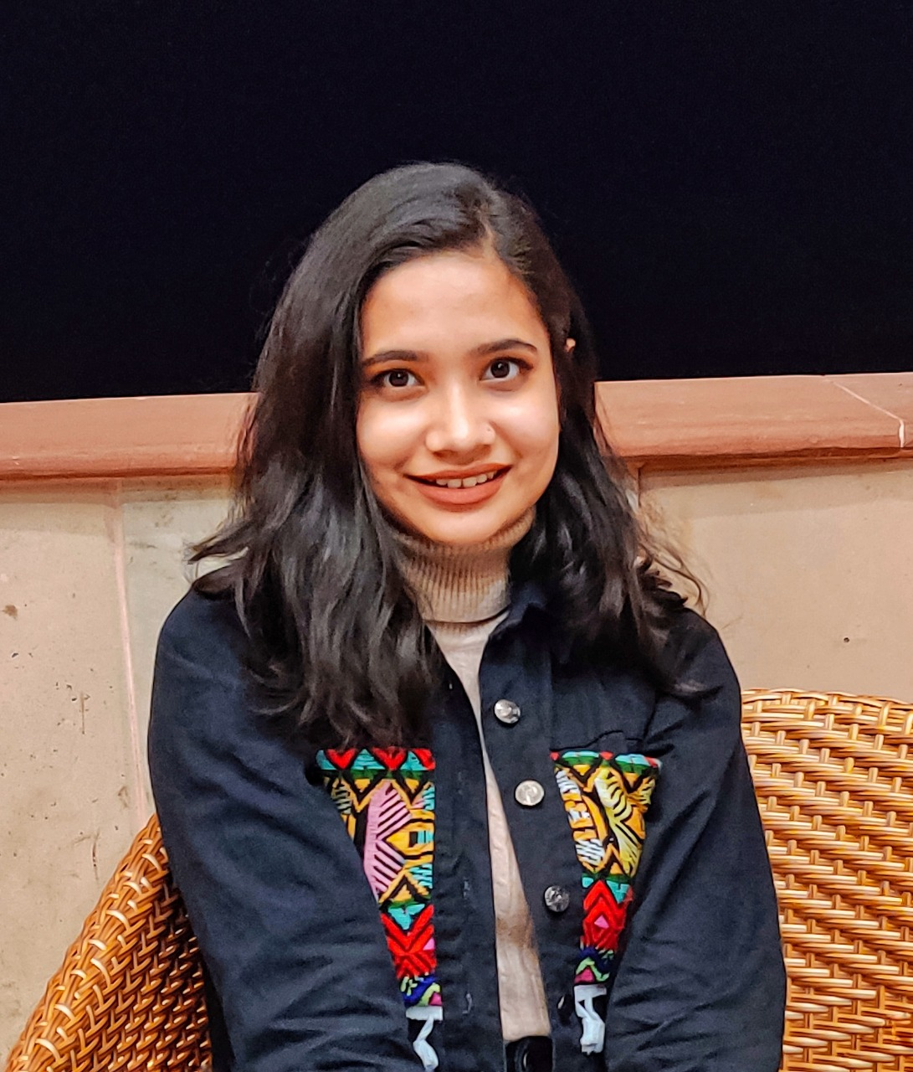
Vasundhara Singh Parihar, Council Member State Council Member – Madhya Pradesh (YOUTH & COMMUNITY EMPOWERMENT COUNCIL) WICCI
BIO:- Employed as a Programme Officer with the School for Social Entrepreneurs India. She also oversees the company's communications.
Her vision of women's empowerment is of a future in India in which girls and women are free to pursue their ambitions and live for themselves. India, which promotes and encourages women's sense of self-worth.

Slide 34
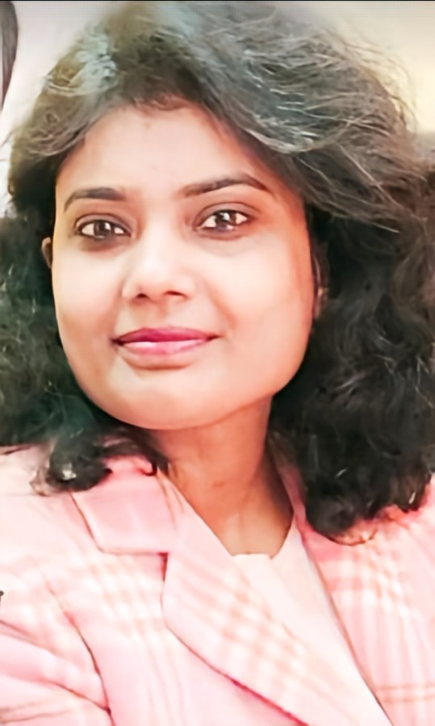
Tripti Agrawal, Council Member State Council Member – Madhya Pradesh (YOUTH & COMMUNITY EMPOWERMENT COUNCIL) WICCI
BIO:- She is an active Social Worker and works at the Shobha Devi Committee (Family of Orphan Daughters) where they have adopted 75 orphan daughters and educated them, made them self-dependent, opened accounts in their names with INR 500/- in various banks for each. She has also gotten 24 daughters married so far and born all the expenses.

Slide 35
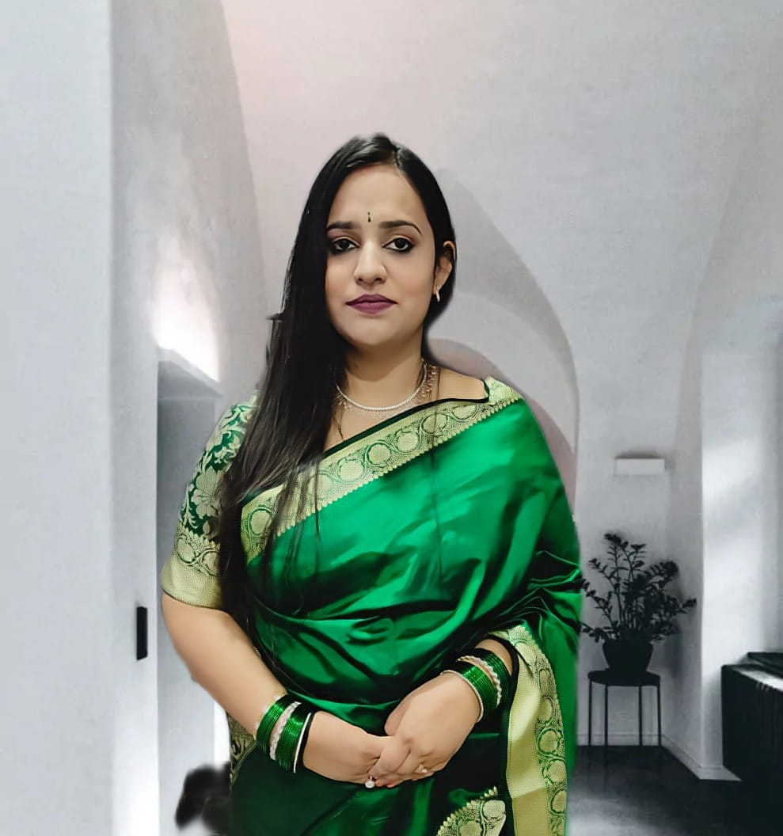
Neha Parihar Chauhan, Council Member State Council Member – Madhya Pradesh (YOUTH & COMMUNITY EMPOWERMENT COUNCIL) WICCI
BIO:- She is an Entrepreneur and looking after my family Pharmaceutical business. She obtained B. Tech in Electronics & Communication from Technocrats Institute of Technology affiliated from Rajeev Gandhi Proudyogiki Vishwavidyalaya, Bhopal, Madhya Pradesh. She desires to help the elderly citizens, who are forced to leave their homes.

Slide 36
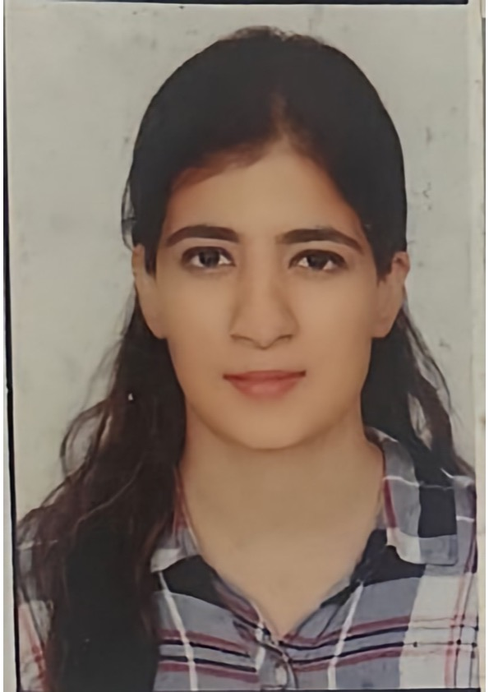
Monisha Kasturi, Council Member State Council Member – Madhya Pradesh (YOUTH & COMMUNITY EMPOWERMENT COUNCIL) WICCI
BIO:-Advocate at High Court of Madhya Pradesh, Bench at Indore, National Company Law Tribunal, Bench at Indore and District Courts at Bhopal & Indore, M.P. Her idea of entrepreneurship revolves around recognising opportunities and generating creative and innovative ideas. She is also a firm believer of women empowerment and supports it as she feels every woman should have the ability to make her own choices.

Slide 37
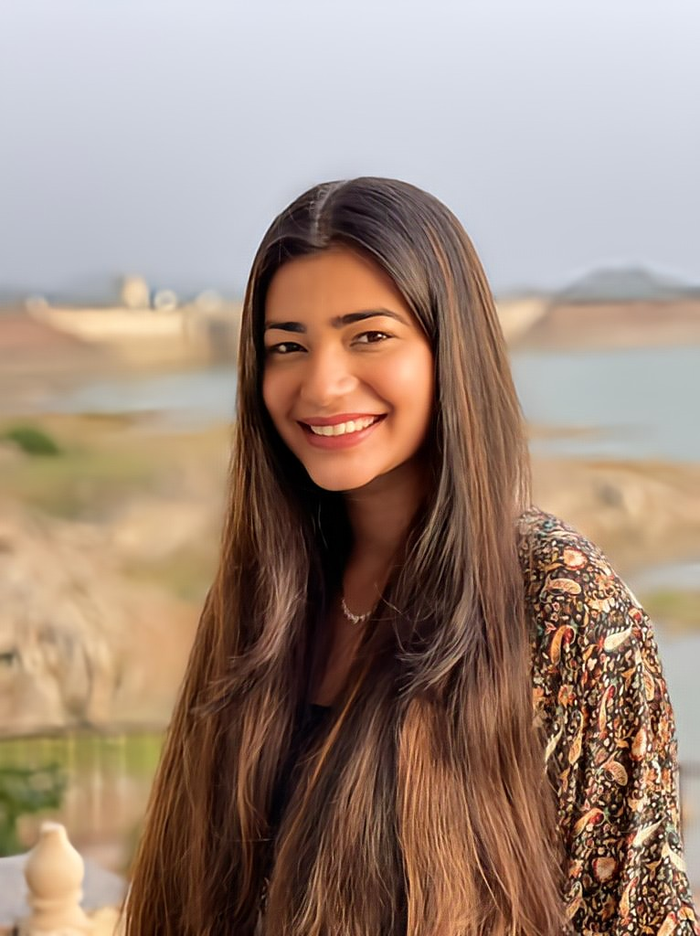
Krishna Bajpai Chauhan, Council Member State Council Member – Madhya Pradesh (YOUTH & COMMUNITY EMPOWERMENT COUNCIL) WICCI
BIO:- Ms. Krishna Bajpai Chauhan is a Makeup Artist by profession. She is Self Employed. Her idea of Women Empowerment is Women promoting women, educating them, working with women as much as possible and giving them the rights to enable women make choices/decisions.

Slide 38
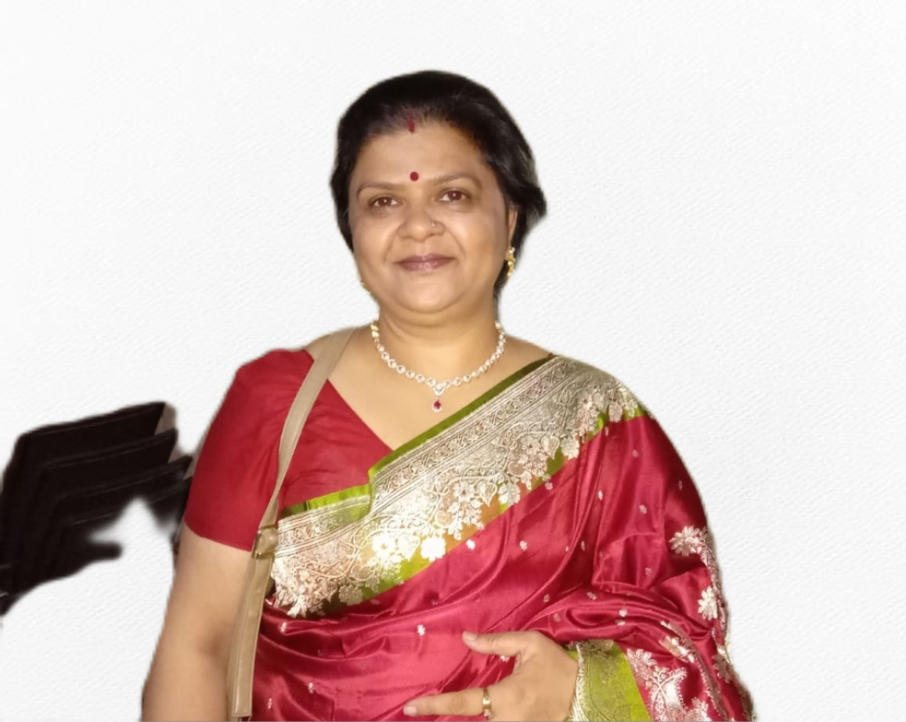
Anita Gupta, Council Member State Council Member – Madhya Pradesh (YOUTH & COMMUNITY EMPOWERMENT COUNCIL) WICCI
BIO:- Anita Gupta is a Government Prathmik Shikshak (Teacher). She believes that the root cause all the problems for women is improper and incomplete education at the threshold and she vows to make the education system better for the overall development of girl children at large.

Slide 39
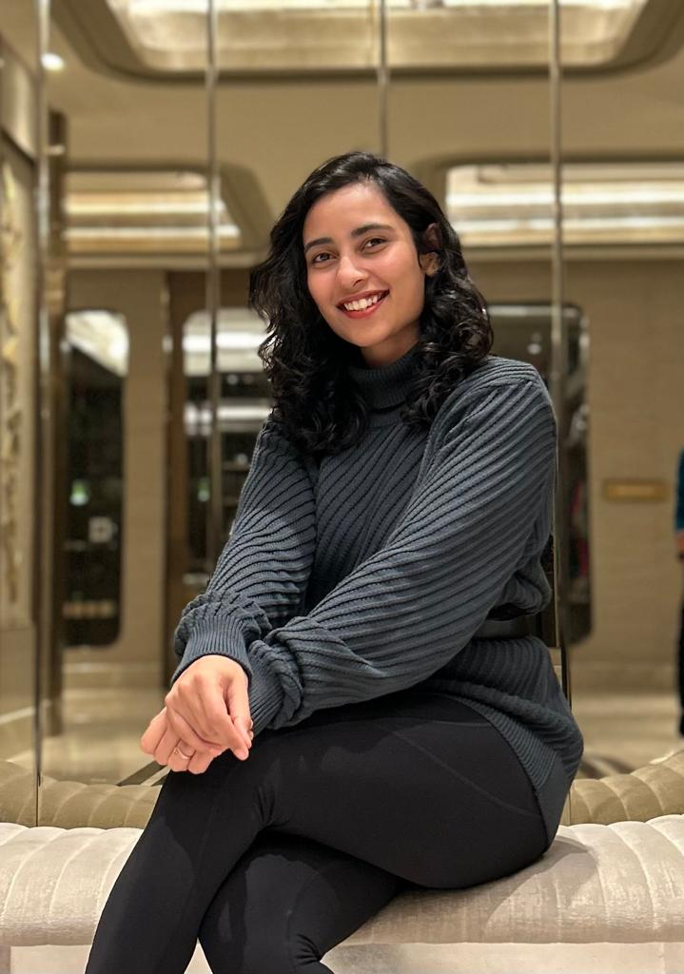
Stuti Bhadauria, Council Member State Council Member – Madhya Pradesh (YOUTH & COMMUNITY EMPOWERMENT COUNCIL) WICCI
BIO:-Co-Founder at Superior Fitness Gym at Bhopal, being the Central India’s First Personal Training Studio. She is an entrepreneur in fitness education, training and academia. Her vision of women empowerment is to develop better opportunities for every generation of women and help them get rid of mental shackles placed by themselves and the society.

Slide 40
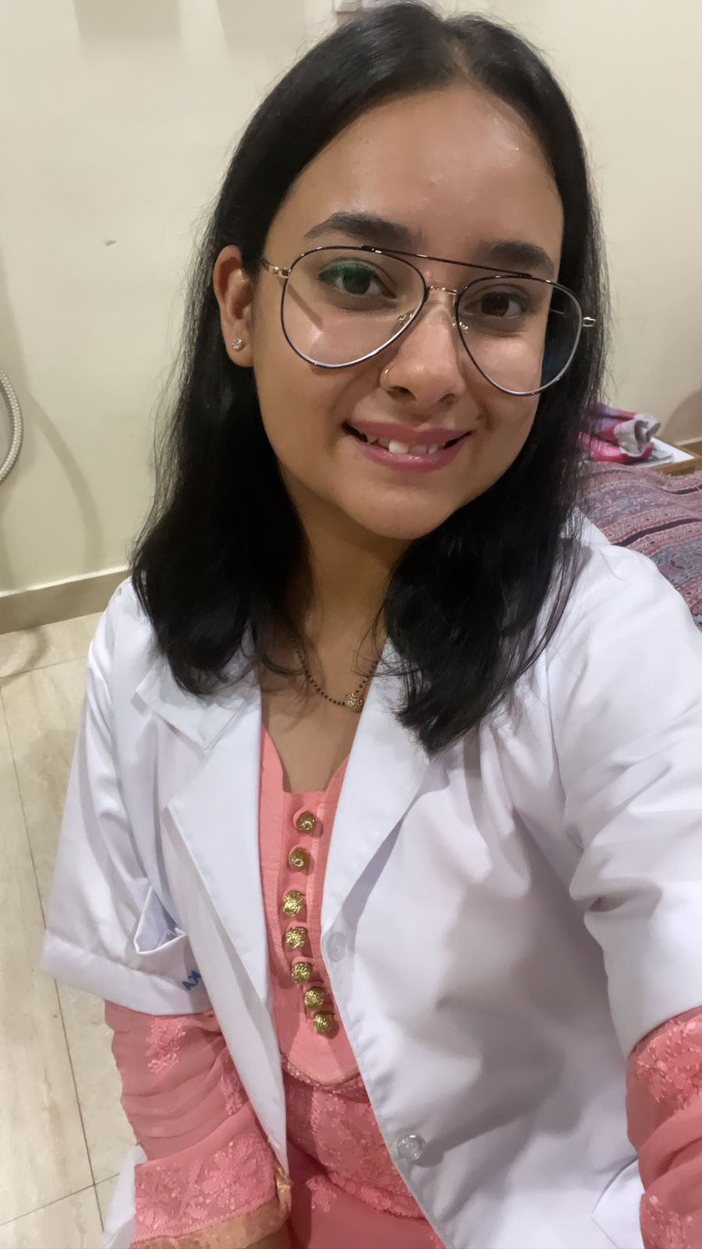
Dr. Anshi Singh, Council Member State Council Member – Madhya Pradesh (YOUTH & COMMUNITY EMPOWERMENT COUNCIL) WICCI
BIO:-MBBS, MD Psychiatry (Self Employed). She completed her MBBS from Barkatuallah University Bhopal & MD from LNCT University, Bhopal. Post that she worked as an intern for 1 year in J.K. Hospital Bhopal & 2 years as a JR in Kalawati hospital in Meerut. When she is not working, you will find her reading, watching shows/documentaries, petting dogs, and doing a bit of craft/art.

Slide 41
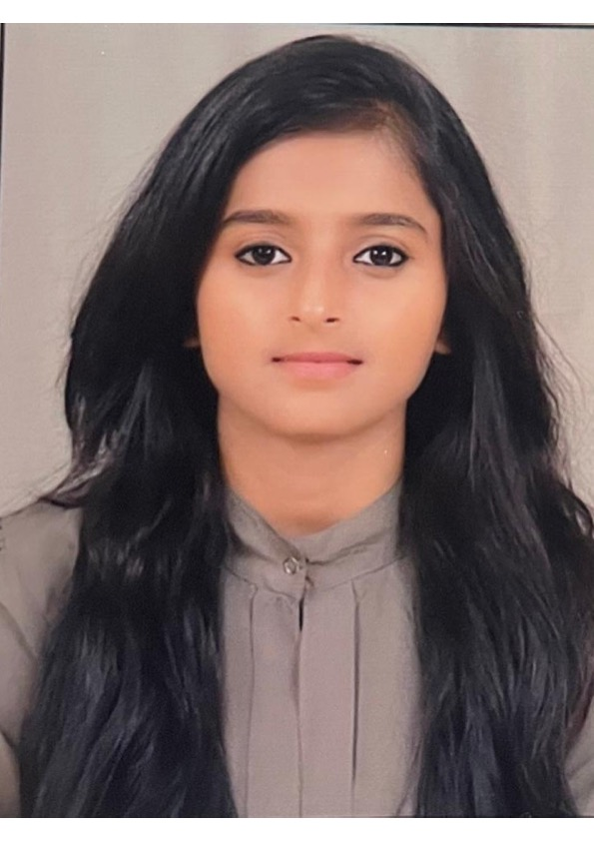
Nishi Soni, Council Member State Council Member – Madhya Pradesh (YOUTH & COMMUNITY EMPOWERMENT COUNCIL) WICCI
BIO:-Currently a student of APCA pursuing (International Diploma in Baking and Pastries Arts) from Gurgaon, Haryana. She has an MBA degree in Tourism and Travel Management and a graduation degree in Human Resource Development and Marketing. According to her, knowledge and courage are the only weapon that allow you to access opportunity and advancement.

Slide 42
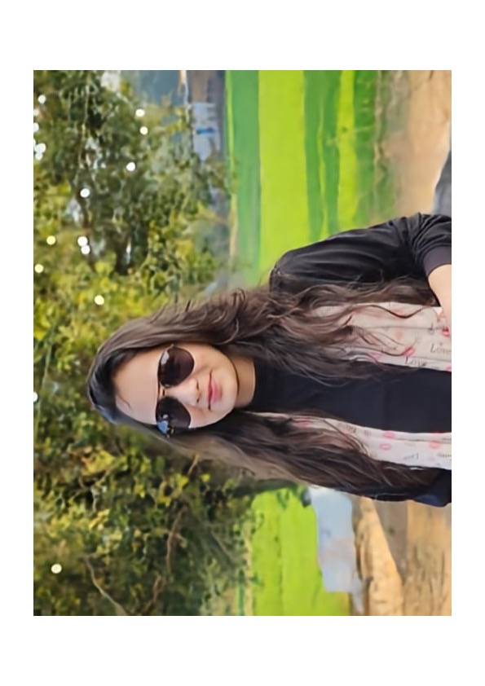
Gauri Chauhan, Council Member State Council Member – Madhya Pradesh (YOUTH & COMMUNITY EMPOWERMENT COUNCIL) WICCI
BIO:- Having completed her BDS, Ms. Gauri Chauhan is a dentist by profession. She loves helping her patients & has a wish to do something better for the society.

Slide 43
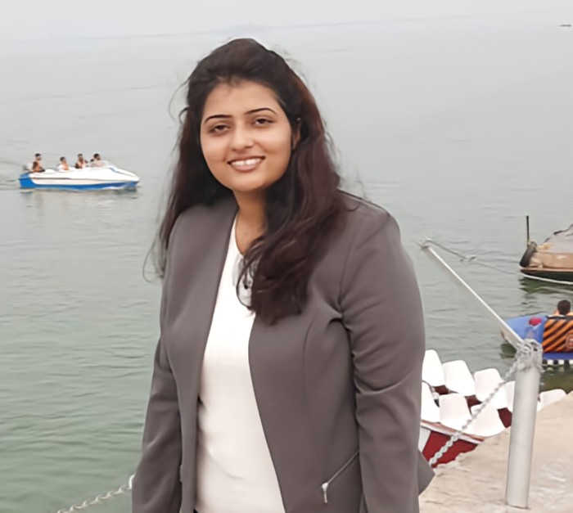
Ojaswi Bundela, Council Member State Council Member – Madhya Pradesh (YOUTH & COMMUNITY EMPOWERMENT COUNCIL) WICCI
BIO:-Ojaswi Bundela is a Research Scholar in Law Discipline. Her vision of women's empowerment is empowering women with social rights, economic stability, political rights and judicial strength. Promoting women's sense of self worth and power to control their own lives, both within and outside the home is of utmost importance to her.

Slide 44
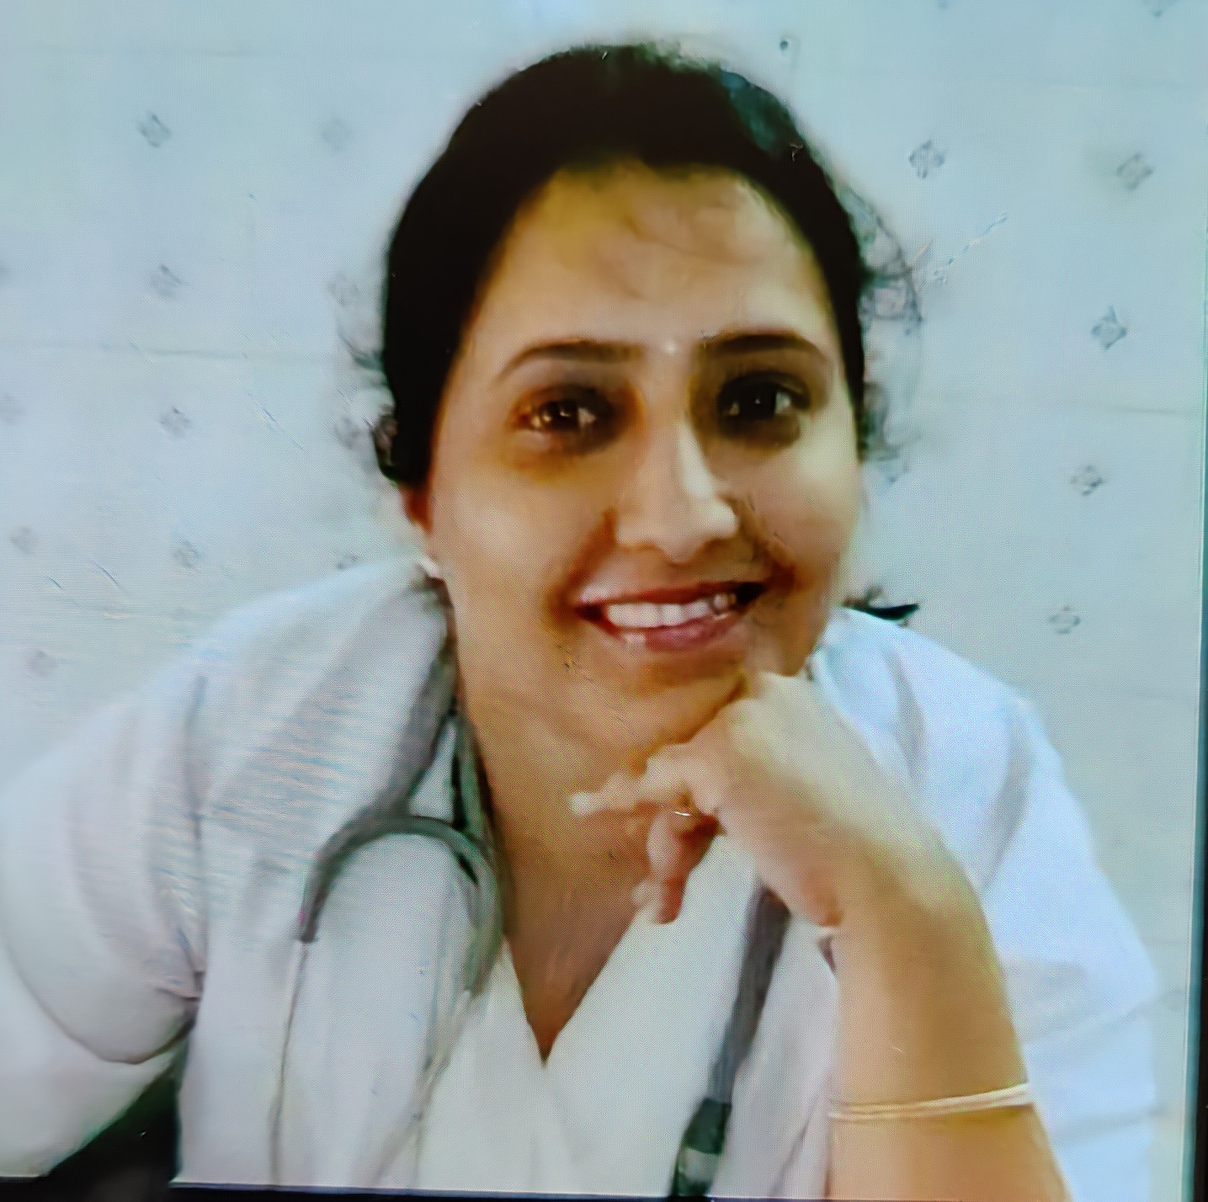
Dr. Megha Oberoi, Council Member State Council Member – Madhya Pradesh (YOUTH & COMMUNITY EMPOWERMENT COUNCIL) WICCI
BIO:- Dr. Megha Oberoi is an Independent Medical Practitioner.
She is an MBBS from Era Medical College, Lucknow, Uttar Pradesh and an MD/MS in Tubercolosis and Chest from D.Y. Patil, Pune.

Slide 45
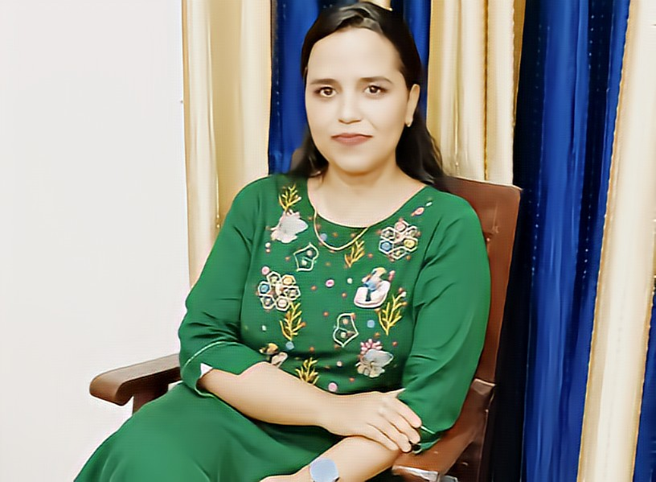
Jyoti Payasi, Council Member State Council Member – Madhya Pradesh (YOUTH & COMMUNITY EMPOWERMENT COUNCIL) WICCI
BIO:- Assistant Professor at Pt. Motilal Nehru PG Law College and Research Centre, Chhatarpur, Madhya Pradesh. She believes that women are already empowered, and they just need to realize it and bring their dreams into action.

Slide 46
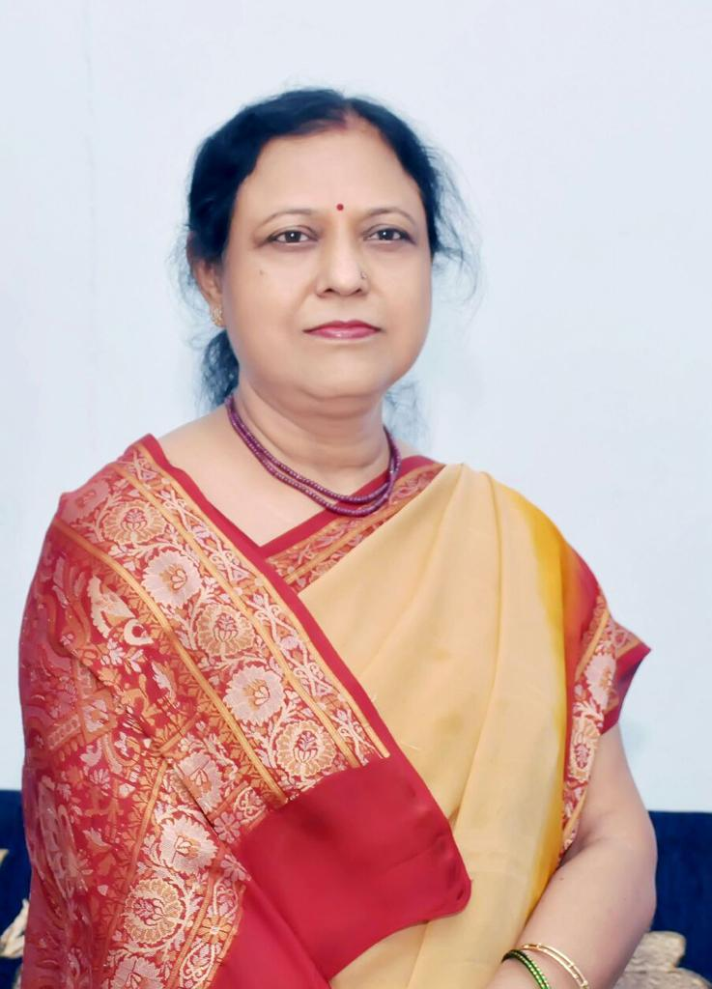
Indu Agrawal, Council Member State Council Member – Madhya Pradesh (YOUTH & COMMUNITY EMPOWERMENT COUNCIL) WICCI
BIO:- Mrs. Indu Agrawal is an Active Social Worker. Her idea of women empowerment is 'Working towards raising awareness for better health & Safety and raising the status of women through education, literacy & training.'

Slide 47
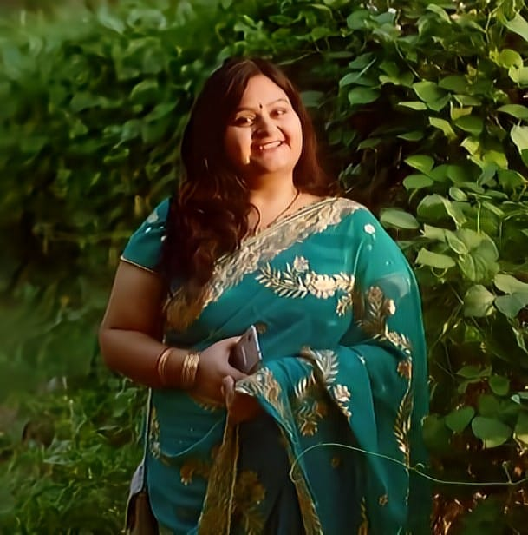
Minakshi Pateria, Council Member State Council Member – Madhya Pradesh (YOUTH & COMMUNITY EMPOWERMENT COUNCIL) WICCI
BIO:- Ms. Minakshi Pateria is a veterinary Doctor and she is serving the community by treating the voiceless. According to her, Education brings wisdom to empowerment.

Slide 48
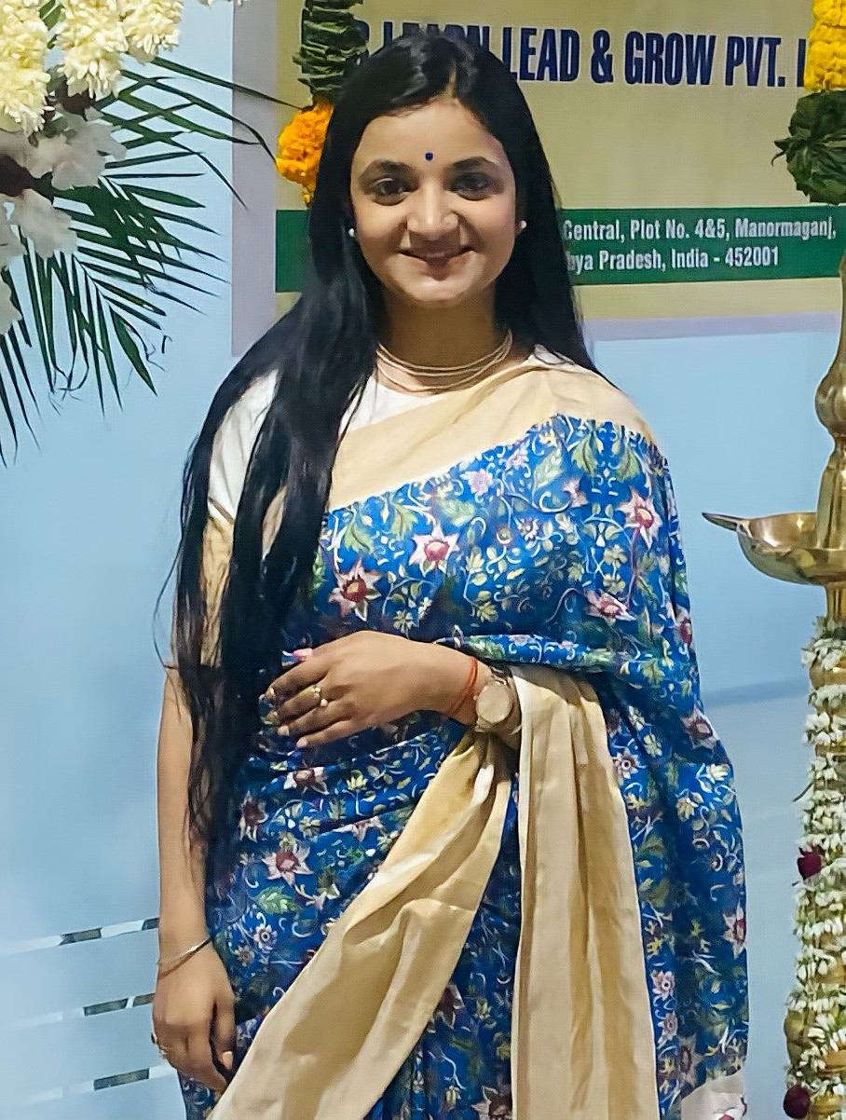
Purnima Pathak, Council Member State Council Member – Madhya Pradesh (YOUTH & COMMUNITY EMPOWERMENT COUNCIL) WICCI
BIO:-Purnima Pathak Poornima completed her engineering and then went on to pursue her master's in social work specialising in psychiatry.She is currently pursuing her PhD in Social Work. Alongside her education in Social Work, she also completed her diploma in Fashion Designing. She has practiced as a psychologist and some of her notable works in social work includes working with childline that falls under the Ministry of Women and Child Development to help children in distress. Childline helped her to work with children across the board right from children with visual impairment to special needs. Further, she managed to work shortly with Jaipur foot as well. Apart from keeping herself engaged in social work, she loves to write. At present, she is spending her time writing a book and hopes to publish it soon. Poornima is a firm believer of being the change you want to see in the world and wants to continue to explore opportunities to leave the world in a better place than she found it.

Slide 49
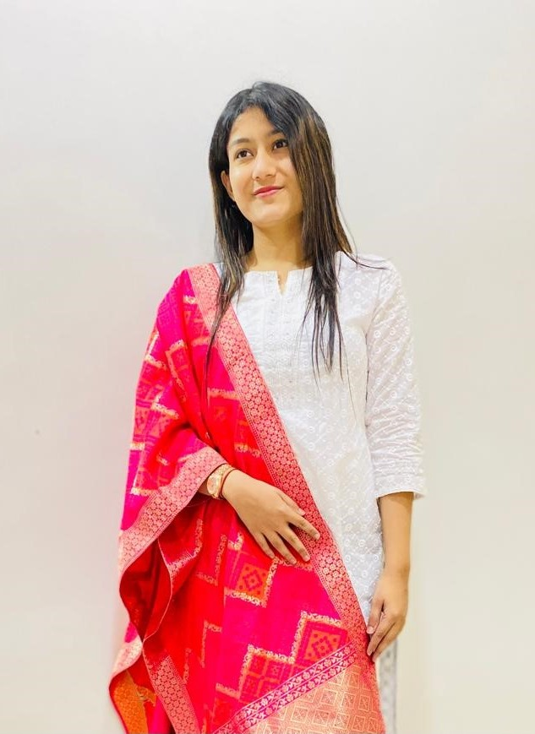
Harshita Negi, State President (Gujarat) State President - Gujarat (YOUTH & COMMUNITY EMPOWERMENT COUNCIL) WICCI
BIO:-Ms. Negi is a self motivated individual working with a leading travel tech company as a Global Business Manager. She believes in team work and have worked for women rights and child education by serving in a NGO called Lights of hope in Vadodara. Her interests include Public Speaking, Social work and awareness. She practices NLP and have an interest in topics like psychology and mental health.

Slide 50
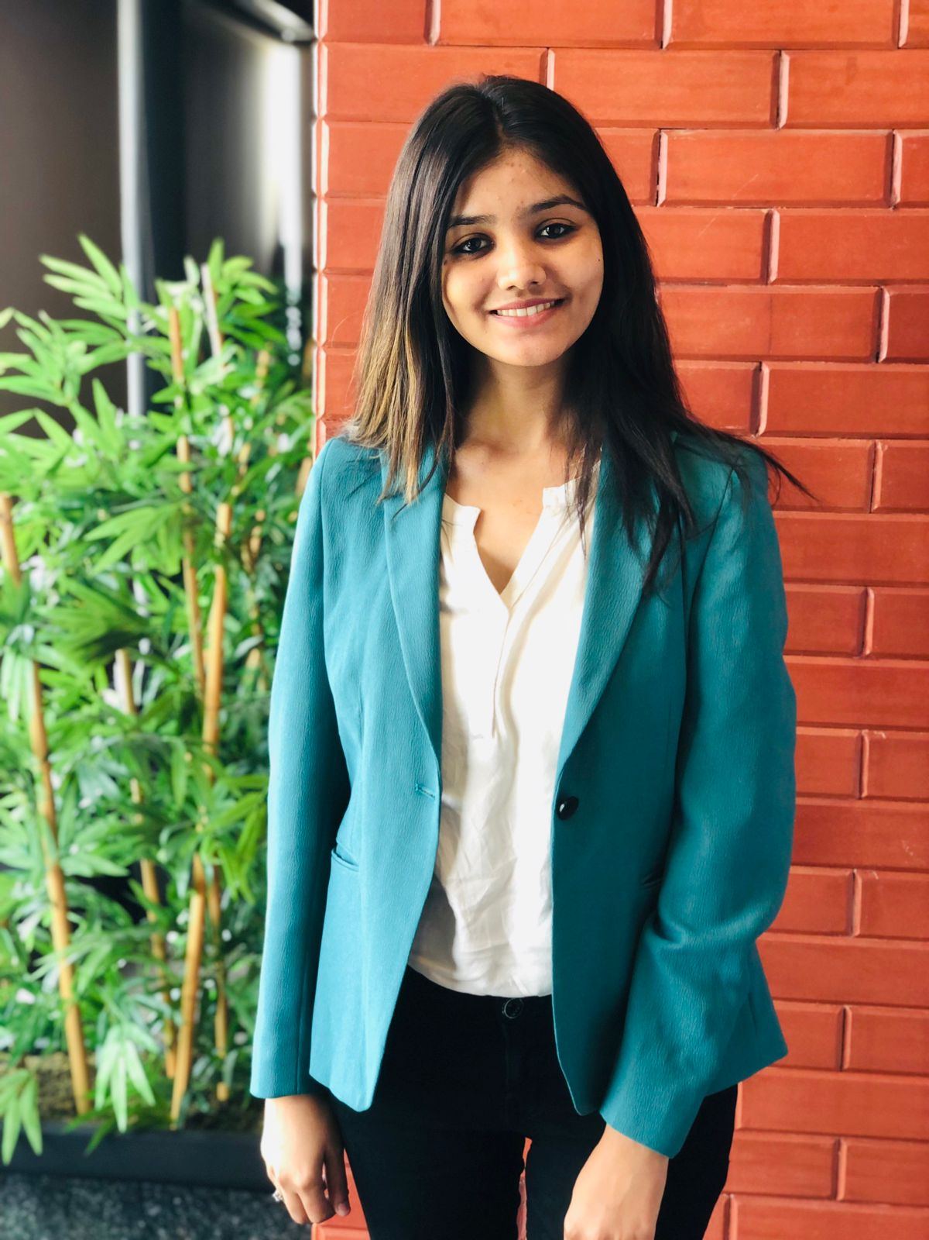
Mansi Patel, State Vice President (Gujarat) State Vice President - Gujarat (YOUTH & COMMUNITY EMPOWERMENT COUNCIL) WICCI
BIO:-Ms. Mansi Patel is a model and a cryptopreneur who is interested in working for the health sector by providing pure water. Mansi is an owner partner of kangen water which is a water purification system to improve health. She takes active participation in health awareness events and often visits places to impart knowledge on the importance of health and fitness.

Slide 51
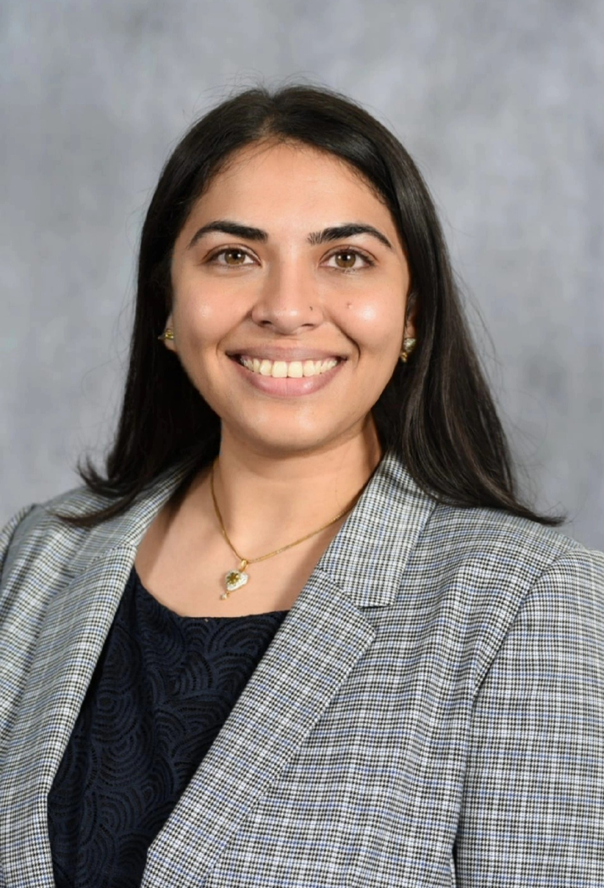
Riya Parikh, Council Member State Council Member – Gujarat (YOUTH & COMMUNITY EMPOWERMENT COUNCIL) WICCI
BIO:-Growing up in India, Ms. Parikh saw a dearth of healthcare awareness initiatives for women and
decided to put her educational training and background as a pharmacist to use by writing patient
information articles for women’s health and wellness. She aspires to bridge the gap between knowledge and wellness through integration of physical well-being and mindfulness.

Slide 52
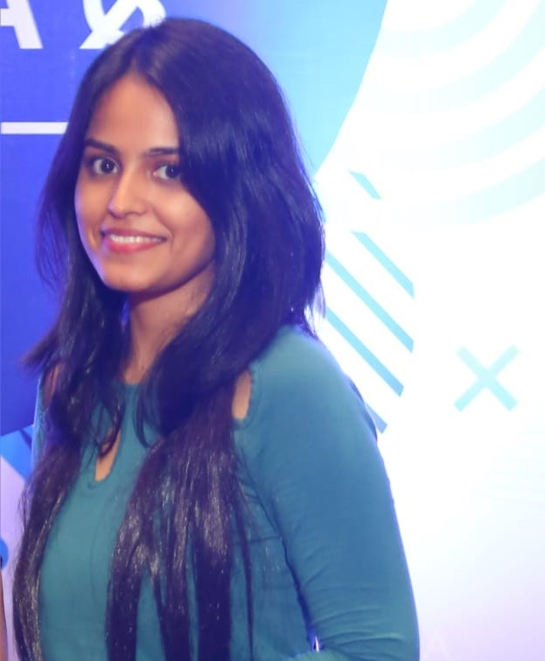
Suchi Sharma, Council Member State Council Member – Gujarat (YOUTH & COMMUNITY EMPOWERMENT COUNCIL) WICCI
BIO:-Ms. Suchi Sharma is a legal researcher in AMS Inform pvt ltd. Her interests are constitutional law, privacy laws and assault cases for minors. Her vision is to deliver effective and skilled representation to under-priveleged victims of abuse.

Slide 53
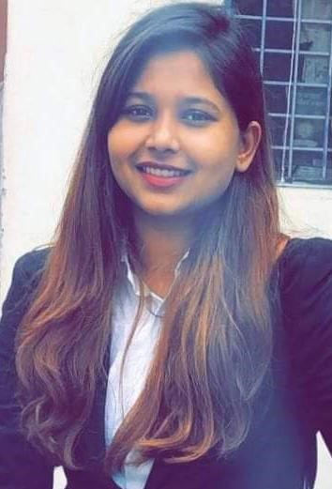
Mudita Rajput, Council Member National Council Member (YOUTH & COMMUNITY EMPOWERMENT COUNCIL) WICCI
BIO:-Ms. Mudita Singh Rajput is working as a consultant for a legal firm. Her interests include making women aware about their laws and work for justice to contribute for a peaceful society.

Slide 54
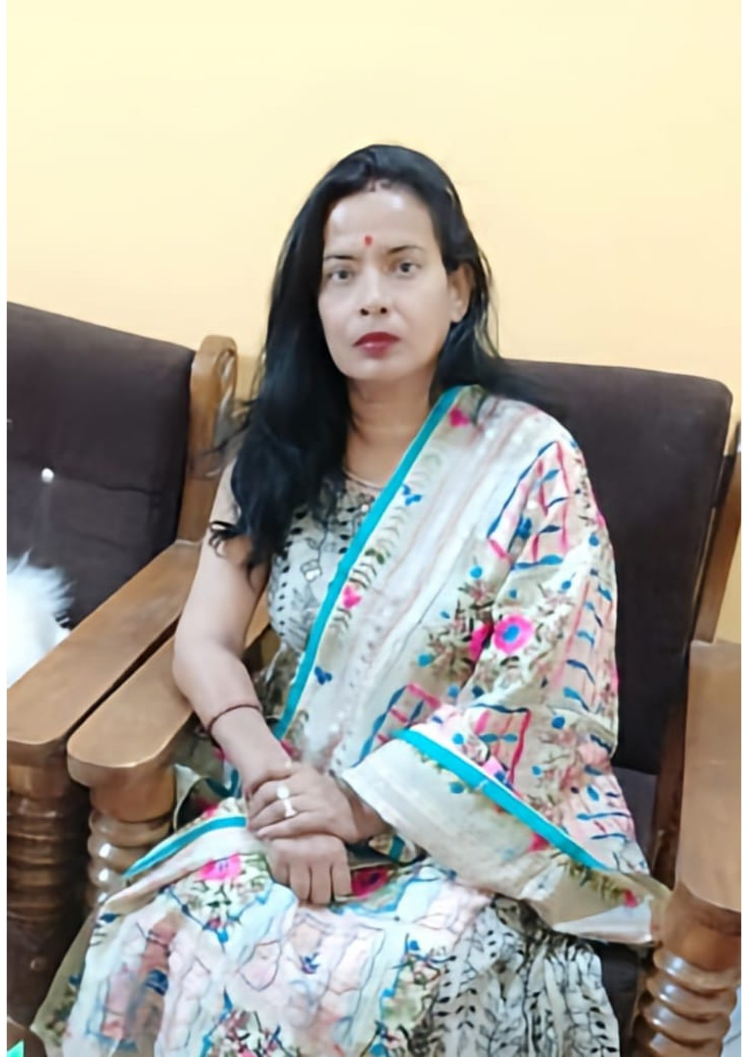
Sashi Singh Parihar, Council Member State Council Member – Madhya Pradesh (YOUTH & COMMUNITY EMPOWERMENT COUNCIL) WICCI
BIO:- She currently resides and works in Nowgong, Chhatarpur, Chhatarpur, Madhya Pradesh. Shashi has achieved recognition for her work in the area of prevention of domestic violence and as a women's trainer her dedication to empowering women is evident in her tireless efforts to promote gender equality and provide support and resources to those who have experienced abuse. Through her work, Shashi has become a role model for women in her community and beyond, inspiring others to join the fight for women's rights and empowerment.

Slide 55
Himaja Sathuluri, Council Member State Council Member – Gujarat (YOUTH & COMMUNITY EMPOWERMENT COUNCIL) WICCI
BIO:- Himaja Sathuluri is a Senior ASCP Conultant for Oracle Cloud Supply Chain planning. She has completed her Bachelors in Architecture from Ramaiah Institute of Technology. She has received ‘Rising Star’ Award for her excellent performance and outstanding contributions in Q3 2022-23.

Slide 56
Simran Malhotra, Council Member State Council Member – Gujarat (YOUTH & COMMUNITY EMPOWERMENT COUNCIL) WICCI
BIO:- Ms. Simran Malhotra is a Programmatic Account Manager with an experience of working in the fields of Campaign Management and Key Account Management. She is Skilled in Programmatic Media Buying, Client Servicing, Account growth strategies, Social Media Marketing Platform Solutions and Brand Management. She is an Exponent Marketing professional with Business academic background. Apart from this she is also an Artist living in a pile of non-fiction books and paints.

Slide 57
Soujanya Prabhu Nayak, Council Member State Council Member – Gujarat (YOUTH & COMMUNITY EMPOWERMENT COUNCIL) WICCI
BIO:- Ms. Soujanya Prabhu Nayak is a CRM expert with 9+ years of experience, handling various roles and currently working as AVP-Product at Kapturecrm. She started her career as CRM executive/manager and handled implementation of domestic and international projects, managed customer service team at Kapture crm for 4 years.

Slide 58
Ayushi Maheshwari, Council Member State Council Member – Gujarat (YOUTH & COMMUNITY EMPOWERMENT COUNCIL) WICCI
BIO:- Ms. Ayushi Maheshwari completed her MBA, on marketing. She is a Lead Generation and Email Marketing Professional who effectively multitasks and is skilled in managing multiple priorities with a positive attitude. She efficiently builds long-term relationships with customers while consistently achieving targets. She has also achieved ‘Employee of the Month award (July 2022)’ for her achievements and continuous improvement. She is open to learning opportunities. She is currently working as a client engagement manager in Calsoft.

Slide 59
Priyanka Agarwalla, Council Member State Council Member – Delhi (YOUTH & COMMUNITY EMPOWERMENT COUNCIL) WICCI
BIO:- Ms. Priyanka Agarwalla is an experienced textile and fashion designer with her bachelors degree in textile design from National institute of fashion technology. With 8+ years of experience in the retail sector, her expertise lies in Western Wear, Indian Wear, and entrepreneurial venture in home furnishings. Currently she has Co-founded a kidswear clothing brand named Kittles ( A unit of Glossglow Private Limited) which caters to fun and quirky kids clothing line. Priyanka’s designs effortlessly blend modernity with a unique touch. Beyond her professional pursuits, she finds inspiration in doodling and gardening.Priyanka has a passion for design and through this platform she aspires to promote women empowerment specially at the grass root level by promoting crafts from different regions of India and to bring a positive change into the fashion and textile industry.

Slide 60
Mehak Alam, Council Member State Council Member – Delhi (YOUTH & COMMUNITY EMPOWERMENT COUNCIL) WICCI
BIO:- Ms. Mehak Alam has pursued English (hons) from Gargi College, Delhi University and M.A English from LSR. Currently she is working as Project Manager at Antworx Experience Private Limited in Delhi. Her views on women empowerment are based on 2 pillars- the ‘emotional’ and the ‘material’. “I feel women in India and in particular cultures are taught to be submissive and docile towards others, especially patriarchs of the family. This acts as a hindrance towards their empowerment as it prevents them from exploiting their potential to the fullest. Even women who have monetary backing or are financially independent are found to be lacking emotional independence. This, I feel, is the first thing that needs rectification (The emotional aspect) Related to this is the material aspect. Unless women are financially independent, it is impossible to think of emotional independence. Financial independence imparts the ability to take independent decisions. It gives confidence to achieve new goals in life and explore new horizons. This is especially valid for women from lower socio-economic backgrounds. I will be very happy to assist such women who need financial backing and help in job placements.” – says Mehak Alam.

Slide 61
Shanya Agnihotri, Council Member State Council Member – Madhya Pradesh (YOUTH & COMMUNITY EMPOWERMENT COUNCIL) WICCI
BIO:- Ms. Shanya Agnihotri is a budding entrepreneur from Indore, Madhya Pradesh. She is currently working on a start up on a cosmetic brand. Her idea of Women Empowerment is that, Women are the backbone of families and communities. There is no limit to what we, as women, can accomplish.
.

Slide 62
Bhanu Agnihotri, Council Member State Council Member – Madhya Pradesh (YOUTH & COMMUNITY EMPOWERMENT COUNCIL) WICCI
BIO:- Smt. Bhanu Agnihotri is from Nowgong, District Chhatarpur, Madhya Pradesh. Her idea of Women Empowerment is that, 'Empowerment isn’t about making women stronger. Women are already strong, it’s about changing the way the world perceives that strength.'.

Slide 63
Dr. Prachi Maheshwari, Council Member State Council Member – Madhya Pradesh (YOUTH & COMMUNITY EMPOWERMENT COUNCIL) WICCI
BIO:- Dr. Prachi Maheshwari is Professor at Prestige Institute of Management And Research, Indore, Madhya Pradesh. Her idea of women empowerment is that, behind every successful women, there is a tribe of other successful women who have her back.

Slide 64
Soyal Puri Goswami, Council Member National Council Member (YOUTH & COMMUNITY EMPOWERMENT COUNCIL) WICCI
BIO:-Ms. Soyal Puri Goswami is a Student at Maharaja Chhatrasal Bundelkhand University Chhatarpur, Madhya Pradesh. Her idea of Women Empowerment/Social Development or well-being: Women have suffered a lot through the years at the hands of men. In earlier centuries, they were treated as almost non-existent. As if all the rights belonged to men even something as basic as voting. Now need to women empowernent,according to me women empowernent is process by which women gain power and control over their own lives and acquire the ability to make strategic choices.

Slide 65
Shalini Singh, Council Member State Council Member - Delhi (YOUTH & COMMUNITY EMPOWERMENT COUNCIL) WICCI
BIO:-Ms. Shalini Singh is an Advocate practicing at the Hon'ble Supreme Court of India. She graduated from the University of Delhi with a Bachelor of Arts (B.A.) in Political Science. She earned her LLB from Amity University's law school in Noida. She has been associated with a number of non-governmental organizations (NGOs) working in the area of women's empowerment and has done so throughout her academic career. She believes that women should be treated equally in all spheres of life, including the home and the workplace.

Slide 66
Sakshi Garg, Council Member National Council Member (YOUTH & COMMUNITY EMPOWERMENT COUNCIL) WICCI
BIO:-Ms. Sakshi Garg is a certified soft skills coach from Indian Leadership Academy. She has clients from all over the globe. She has conducted hundreds of workshops both online as well as offline to transform people’s lives with 21st century skills. Her mission is to adept each & every individual with socio emotional skills to deal with the fast paced world.

Slide 67
Sharada Kumar, Council Member State Council Member - Karnataka (YOUTH & COMMUNITY EMPOWERMENT COUNCIL) WICCI
BIO:- Smt. Sharada Kumar is a M. A, B. Ed. She is a special Educator with Dyslexic, rather specially abled children, also a counselor to them. She is an Artofliving Teacher, teaching Happiness programs. She is also an owner of a Spa and Salon for women in Kanakapura road, Bangalore. Other than these, she is also a board member of a startup called Health4silvers, where they cater to the health needs of senior parents staying in India whose children are based abroad. She is planning to start one in India for Indian senior parents whose children are also in India but stay in different cities. She is an enthusiastic car and bike ralliest and she ha won many prizes. She was also a second runner up in a beauty pageant. She is interested in doing lot of social work.

Slide 68
Pooja Faldu, Council Member State Council Member - Gujarat (YOUTH & COMMUNITY EMPOWERMENT COUNCIL) WICCI
BIO:- Ms. Pooja Faldu basically hails from Rajkot, but she has been living in Ahmedabad for the past 3 years. She is a Lawyer by profession, but her heart lies in Nail Art. She has over 5+ years of professional nail artistry experience. She owns a Nail Studio in Ahmedabad. She is a travel enthusiast with a dream of exploring every corner of India. With this she also wants to serve women and create a better world for all.

Slide 69
Nidhi Jain, Council Member State Council Member - Gujarat (YOUTH & COMMUNITY EMPOWERMENT COUNCIL) WICCI
BIO:- Ms. Nidhi Jain is a VAT analyst and a social work enthusiast. She hails from Vadodara, Gujarat. Her hobbies are travelling, reading about current affairs and listening to music. Apart from her work, she would like to contribute her time for the betterment of women and need a chance to work with team Youth & Community Empowerment Council – WICCI.

Slide 70
Diksha Chourasia, Council Member National Council Member (YOUTH & COMMUNITY EMPOWERMENT COUNCIL) WICCI
BIO:- Ms. Diksha Chourasia describes herself as an NSS Volunteer, Management Student, Creative Enthusiast. In her own words, “On a path to learn and lead, I'm a management student passionate about community service and creating a better society driven by compassion and positivity. Probing the art of leadership as a management student. Actively engaged in NSS, where I discovered the power of change through hands-on experience. Dedicated to Women and Child Development, honing my skills with various NGOs. Animal enthusiast, active in the cause of Animal Welfare. Spreading awareness about Thalassemia and supporting those in need. Aspiring to make a lasting impact on children's lives, and raising awareness for Child Labour with a major goal to work and make a difference with UNICEF. Infusing creativity into the world through artwork and innovative endeavours.”

Slide 71
A Shilpa Achary, State President (Odisha) State President - Odisha (YOUTH & COMMUNITY EMPOWERMENT COUNCIL) WICCI
BIO:-Ms. A Shilpa Rani Achary is a dedicated advocate practicing at the Orissa
High Court. She holds a B.A. LL.B degree and has further honed her expertise with an LL.M in Medical and Health Law. Known for her hardworking and efficient approach, she passionately advocates for her clients&#39; rights within the legal domain. She deals with matters related to Medical laws, Consumer laws, Real Estate Laws, Service Laws, Civil Laws, Arbitration Laws, Family Laws and Contact laws.

Slide 72
Rajlaxmi Samal, State Vice President (Odisha) State Vice President - Odisha (YOUTH & COMMUNITY EMPOWERMENT COUNCIL) WICCI
BIO:-Ms. Rajlaxmi Samal is an advocate with a profound legal acumen having qualification on Bachelor of Laws (B.A. LL.B) qualification. Her career is inclined to field of law. She has been marked by dedication, integrity, and an unwavering commitment to justice. In her words, she is on a mission to build such a remarkable personality and tireless pursuit of justice & continue to leave a lasting impact on the legal profession and society as a whole.

Slide 73
Sucheta Gurmansingh, Council Member (Odisha) State Council Member - Odisha (YOUTH & COMMUNITY EMPOWERMENT COUNCIL) WICCI
BIO:-Ms. Sucheta Gumansingh is an accomplished advocate based in the Orissa High Court, known for her expertise in a wide range of legal fields. She specialises in various areas of law, including insurance law, service law, company laws, motor vehicle act cases, writ petitions, contract law, arbitration law, and family law.

Slide 74
Kalyani Mallick, Council Member (Odisha) State Council Member - Odisha (YOUTH & COMMUNITY EMPOWERMENT COUNCIL) WICCI
BIO:-Ms. Kalyani Mallick is a dedicated educator with a strong background in Geography. She holds the qualification of PGT (Post Graduate Teacher) in Geography and is currently serving as a teacher in the Odisha Adarsha Vidyalaya Sangathan (OAVS), stationed in Keonjhar, Odisha.

Slide 75
Prathama Priyadarshini Kanhar, Council Member (Odisha) State Council Member - Odisha (YOUTH & COMMUNITY EMPOWERMENT COUNCIL) WICCI
BIO:-Ms. Prathama Priyadarshini Kanhar holds a qualification of B.Sc (ITM), and M.A (Public Administration, currently preparing for civil services. She is an ambitious individual who is wholeheartedly dedicated to pursuing a career in civil services. With a strong passion for public service and a desire to make a positive impact on society, she is diligently preparing for her civil services examinations.

Slide 76
Banaja Manjari Kanhar, Council Member (Odisha) State Council Member - Odisha (YOUTH & COMMUNITY EMPOWERMENT COUNCIL) WICCI
BIO:-Ms. Banaja Manjari Kanhar is a skilled professional dancer whose graceful moves and artistic expression captivate audiences. With years of training and passion for dance, she has honed her talent into a captivating art form. Banaja & performances showcase her dedication and creativity, making her a standout in the world of dance.

Slide 77
Arpita Nanda, Council Member (Odisha) State Council Member - Odisha (YOUTH & COMMUNITY EMPOWERMENT COUNCIL) WICCI
BIO:-Ms. Arpita Nanda, a postgraduate in Journalism, is a multifaceted individual who has combined her educational background with entrepreneurial spirit. She is the proud owner of “Titly Horizon Private Limited”, a school that reflects her commitment to quality education. Arpita’s vision and dedication have made Titly Horizon a beacon of learning and innovation in the community, emphasizing her role as an educator and entrepreneur.

Slide 78
Sanyukta Singh, Council Member (Odisha) State Council Member - Odisha (YOUTH & COMMUNITY EMPOWERMENT COUNCIL) WICCI
BIO:-Ms. Sanyukta Singh is a highly educated professional with a strong legal background. She holds a B.A. LL.B degree, which reflects her dedication to the field of law. In addition to her undergraduate qualification, she has also achieved an LL.M degree, demonstrating her commitment to specialization and a deep understanding of legal matters.

Slide 79
Anuradha Kar, Council Member (Odisha) State Council Member - Odisha (YOUTH & COMMUNITY EMPOWERMENT COUNCIL) WICCI
BIO:-Ms. Anuradha Kar, armed with a B.A. LL.B and LL.M, is a legal luminary with a profound understanding of the law. Her dual qualifications reflect a strong commitment to legal excellence. Anuradha’s expertise and academic background make her a formidable presence in the legal field, where she
diligently serves the cause of justice.

Slide 80
Abhankita Pandia, Council Member (Odisha) State Council Member - Odisha (YOUTH & COMMUNITY EMPOWERMENT COUNCIL) WICCI
BIO:-Ms. Abhankita Pandia is a remarkable individual who seamlessly balances the worlds of law and art. With a B.A. LL.B and LL.M, she possesses a strong legal foundation. Beyond her legal pursuits, Abhankita’s passion for dance showcases her artistic talents, making her a versatile and accomplished individual in both the legal and creative realms.

Slide 81
Roogdhatri Mishra, Council Member (Odisha) State Council Member - Odisha (YOUTH & COMMUNITY EMPOWERMENT COUNCIL) WICCI
BIO:-Ms. Roogdhatri Mishra is a multifaceted professional who excels in her career as a Talent Acquisition Specialist. Alongside her corporate endeavors, she is a dedicated trainee in the art of Odissi dance and a committed practitioner of yoga. Roogdhatri’s commitment to both her professional growth and artistic pursuits exemplifies her well-rounded and passionate approach to life.

Slide 82
Dr. Priyadarshini Achary, Council Member (Odisha) State Council Member - Odisha (YOUTH & COMMUNITY EMPOWERMENT COUNCIL) WICCI
BIO:- Dr. Priyadarshini Achary, a dedicated medical professional, holds an M.B.B.S degree and currently serves as a Medical Officer through OPSC in Krushnaprasad, Puri, Odisha. With her medical expertise, she plays a vital role in ensuring the health and well-being of her community. Dr. Priyadarshini’s commitment to healthcare exemplifies her dedication to serving the people of Odisha.

Slide 83
Chinmayee Pradhan, Council Member (Odisha) State Council Member - Odisha (YOUTH & COMMUNITY EMPOWERMENT COUNCIL) WICCI
BIO:- Ms. Chinmayee Pradhan is a brilliant and meritorious student pursuing her dream of becoming a doctor through MBBS at MKCG Medical College and Hospital in Berhampur, Odisha. Her dedication to academics and passion for medicine exemplify her commitment to the field of healthcare. Chinmayee’s journey is an inspiration to aspiring medical professionals.

Slide 84
Dr. Jyotirmayee Pradhan, Council Member (Odisha) State Council Member - Odisha (YOUTH & COMMUNITY EMPOWERMENT COUNCIL) WICCI
BIO:- Dr. Jyotirmayee Pradhan is a skilled clinical researcher, contributing her expertise to the prestigious AIIMS (All India Institute of Medical Sciences). Her work in medical research reflects her dedication to advancing healthcare. Jyotirmayee’s commitment to cutting-edge research plays a pivotal role in improving healthcare outcomes.

Slide 85
Deepika Padhi, Council Member (Odisha) State Council Member - Odisha (YOUTH & COMMUNITY EMPOWERMENT COUNCIL) WICCI
BIO:- Deepika Padhi is a budding entrepreneur with a passion for fashion. She is embarking on a journey to start her small business specializing in clothing and sarees. Deepika’s entrepreneurial spirit and love for fashion are driving her to create a unique and stylish offering for her customers, showcasing her determination and creativity in the world of retail.

Slide 86
Subhranjita Priyadarshini, Council Member (Odisha) State Council Member - Odisha (YOUTH & COMMUNITY EMPOWERMENT COUNCIL) WICCI
BIO:- Ms. Subhranjita Priyadarshini, is equipped with a BSc in Biotechnology, is currently dedicated to her pursuit of an MSc in Toxicology at NFSU in Gujarat. Her academic journey reflects her keen interest in the field of toxicology and her commitment to advancing her knowledge. Subhranjita’s dedication to science and research is commendable and holds promise for a successful career in this specialized area.

Slide 87
Rajashree Jena, Council Member (Odisha) State Council Member - Odisha (YOUTH & COMMUNITY EMPOWERMENT COUNCIL) WICCI
BIO:- Ms. Rajashree Jena is a dedicated professional serving as a banker at HDFC Bank in Cuttack, Odisha. Her financial expertise and commitment to customer service make her a valuable asset to the banking industry. Rajashree’s diligent work in the financial sector contributes to the economic well-being of her community.

Slide 88
Sonali Achary, Council Member (Odisha) State Council Member - Odisha (YOUTH & COMMUNITY EMPOWERMENT COUNCIL) WICCI
BIO:- Ms. Sonali Achary, with a BSc in Physics, passionately imparts her knowledge as a dedicated teacher, shaping the future of aspiring students. Her commitment to education and subject expertise enriches the learning experience for her students.

Slide 89
Sambhabana Mishra, Council Member (Odisha) State Council Member - Odisha (YOUTH & COMMUNITY EMPOWERMENT COUNCIL) WICCI
BIO:- Ms. Sambhabana Mishra, a versatile individual, who manages the roles of both a housewife and a lawyer. Her legal expertise complements her dedication to her family and home. Sambhabana embodies the balance between professional and personal responsibilities with grace and skill.

Slide 90
Saphila Banu, Council Member (Odisha) State Council Member - Odisha (YOUTH & COMMUNITY EMPOWERMENT COUNCIL) WICCI
BIO:- Ms. Saphila Banu is a skilled professional, currently serving as a functional analyst at Airbus in Bangalore. Her expertise in aviation and her role in ensuring the smooth functionality of aircraft systems exemplify her dedication to the aerospace industry. Saphila’s contributions play a crucial part in the safe and efficient operation of Airbus aircraft.

Slide 91
Anchal Shethy, Council Member (Odisha) State Council Member - Odisha (YOUTH & COMMUNITY EMPOWERMENT COUNCIL) WICCI
BIO:- Ms. Anchal is a driven individual, currently pursuing her Masters in Constitutional Law at Utkal University in Bhubaneswar, Odisha. Her passion for legal studies and specialization in constitutional law reflects her commitment to understanding the foundations of governance and justice.

Slide 92
Sipra Suman Pratihari, Council Member (Odisha) State Council Member - Odisha (YOUTH & COMMUNITY EMPOWERMENT COUNCIL) WICCI
BIO:- Ms. Sipra Suman Pratihari is a skilled advocate, lending her expertise to the proceedings of the Orissa High Court. Her legal acumen and dedication to the profession make her a valuable asset in the realm of law. Sipra’s commitment to justice is evident in her work within the esteemed Orissa High Court.

Slide 93
Meera Panda, Council Member (Odisha) State Council Member - Odisha (YOUTH & COMMUNITY EMPOWERMENT COUNCIL) WICCI
BIO:- Ms. Meera Panda, a highly qualified legal professional with a degree in BA LLB and LLM, excels in the field of law. As an advocate, she combines her academic prowess with a passion for justice, representing clients effectively. Meera’s commitment to the legal profession is evident in her expertise and dedication to upholding the law.

Slide 94
Barsha Padhi, Council Member (Odisha) State Council Member - Odisha (YOUTH & COMMUNITY EMPOWERMENT COUNCIL) WICCI
BIO:- Ms. Barsha Padhi, a dedicated homemaker, is also on a journey of personal growth. She is currently pursuing her B.Ed degree, demonstrating her commitment to education and self-improvement. Barsha’s ability to balance her responsibilities as a housewife while investing in her own education is an inspiring testament to her determination and pursuit of lifelong learning.

Slide 95
Bijaylaxmi Samal, Council Member (Odisha) State Council Member - Odisha (YOUTH & COMMUNITY EMPOWERMENT COUNCIL) WICCI
BIO:- Ms. Bijayalaxmi is a dedicated counseling psychologist known for her compassionate and insightful approach to mental well-being. With years of experience, she empowers individuals to navigate life's challenges and find emotional balance. Her commitment to mental health is a guiding light for those seeking support and guidance.

Slide 96
Tejaswini Pradhan, Council Member (Odisha) State Council Member - Odisha (YOUTH & COMMUNITY EMPOWERMENT COUNCIL) WICCI
BIO:- Ms. Tejaswini is a dedicated Sub Inspector in the Excise Department, committed to upholding the law and ensuring the responsible handling of alcoholic beverages. With a strong sense of duty, she works tirelessly to maintain order and enforce regulations in her jurisdiction. Her passion for justice and public safety is unwavering. View on women Empowerment: Decision making power should be given to women & also a platform to share their idea & create change, access to opportunities & resources ,to control over her own Life inside & outside of her home.

Slide 97
Tapaswini Swain, Council Member (Odisha) State Council Member - Odisha (YOUTH & COMMUNITY EMPOWERMENT COUNCIL) WICCI
BIO:- Ms. Tapaswini is a dedicated advocate whose expertise lies in the realm of family law. With a passion for upholding justice within the intricate dynamics of familial relationships, she has carved a niche for herself in this specialized field. Her legal acumen and empathetic approach have earned her the trust of numerous individuals and families seeking guidance in matters of marriage, divorce, child custody, and more. View on Women Empowerment: Unity among the Women is the essence.

Slide 98
Ipsita Priyadarshini, Council Member (Odisha) State Council Member - Odisha (YOUTH & COMMUNITY EMPOWERMENT COUNCIL) WICCI
BIO:- Ms. Ipsita Priyadarshini is a seasoned business analyst known for her keen analytical skills and strategic insights. With a proven track record, she specializes in helping organizations optimize processes and make data-driven decisions for growth. Ipsita's expertise is a driving force behind successful business transformations.

Slide 99
Navonita Mallick, Council Member (Odisha) State Council Member - Odisha (YOUTH & COMMUNITY EMPOWERMENT COUNCIL) WICCI
BIO:- Ms. Navonita Mallick is a lawyer and women's rights activist. She is currently pursuing her PhD in criminal law. She has a strong academic background in law and is committed to using her skills to help women and children who are victims of violence and injustice. View on Women Empowerment: I believe that women empowerment is essential for creating a more just and equitable world. When women are empowered, they are able to reach their full potential and contribute to society in meaningful ways. They are also more likely to be able to protect their rights and well-being. There are many ways to empower women, including through education, economic opportunity, and political participation. It is also important to challenge gender stereotypes and promote positive attitudes towards women and girls. I am hopeful that we can create a world where all women are empowered to live their lives to the fullest.

Slide 100
Subhada Nayak, Council Member (Odisha) State Council Member - Odisha (YOUTH & COMMUNITY EMPOWERMENT COUNCIL) WICCI
BIO:- Ms. Subhada Nayak is a Member in Juvenile Justice Board, Berhampur having 15 years experience in advocacy dealing with all types of cases. View on Women Empowerment: It refers to the efforts and initiatives taken to promote gender equality, enhance women's participation in decision-making processes, improve their access to education, healthcare, and economic opportunities, and eliminate gender-based violence and discrimination.

Slide 101
Simran Mohanty, Council Member (Odisha) State Council Member - Odisha (YOUTH & COMMUNITY EMPOWERMENT COUNCIL) WICCI
BIO:- Ms. Simran Mohanty is a prolific author known for her captivating novels that transport readers to imaginative worlds and explore the depths of human emotions. Her view on women Empowerment is to be vocal about our rights. To ensure empowerment in all spheres; financial, economic, educational, political and legal.

Slide 102
Ipsa Khuntia, Council Member (Odisha) State Council Member - Odisha (YOUTH & COMMUNITY EMPOWERMENT COUNCIL) WICCI
BIO:- Ms. Ipsa Khuntia, a dedicated student, juggles academics while passionately crafting unique ornaments, infusing creativity and entrepreneurship into her small business. View on women Empowerment: To be vocal about our rights. To ensure empowerment in all spheres; financial, economic, educational, political and legal. We can only lead fulfilling lives if we're in this together.

Slide 103
Subhadra Hansda, Council Member (Odisha) State Council Member - Odisha (YOUTH & COMMUNITY EMPOWERMENT COUNCIL) WICCI
BIO:- Ms. Subhadra Hansda, as a novice in the field of law, is both an advocate and a dedicated student pursuing an LLM program with a specialisation in IPR at IIT, KGP. She is a socio-legal management enthusiast and always have a keen interest in continual learning and professional growth. Her view on Women Empowerment: is “The women's empowerment should extend beyond the realm of mere justice,it encompasses the imperative of affording them equal standing within society. This entails granting women the autonomy to exercise their choice, uphold their dignity, access education and enjoy various other fundamental rights.”

Slide 104
Apupa Rath, Council Member (Odisha) State Council Member - Odisha (YOUTH & COMMUNITY EMPOWERMENT COUNCIL) WICCI
BIO:- Ms. Apupa Rath is an aspiring lawyer, writer, budding human rights activist and an artist by passion. Her view of Women Empowerment: Women make 50% of the population and yet struggle to take the same stake in workforce and in the ladder of seniority for numerous reasons. It is time that we relook into the mission of "Beti Padhao, Beti Bachao", focus on not only giving them wings but be the air beneath those wings.

Slide 105
Nensi Gandhi, Council Member (Gujarat) State Council Member - Gujarat (YOUTH & COMMUNITY EMPOWERMENT COUNCIL) WICCI
BIO:- Ms. Nensi Gandhi is a physiotherapist and Professor teaching in Sumandeep University, Gujarat. Her aim is to bring medical awareness to women and contribute in the wellness sector.

Slide 106
SUPPORTED BY
WICCI is supported by the massive global networks of ALL Ladies League (ALL), Women Economic Forum (WEF), and SHEconomy.
ALL is a movement of ‘Sisters Beyond Borders.’
WEF is a platform for ‘Business Beyond Borders.’ SHEconomy is e-commerce for women worldwide in Goods & Services for ‘Commerce Beyond Borders’

Slide 107
COUNTRIES REPRESENTED
Albania, Angola, Armenia, Argentina, Australia, Azerbaijan, Bangladesh, Brazil, Burundi, Cameroon, Canada, Chad, China, Costa Rica, Croatia, Cyprus, Czech Republic, Colombia, Ecuador, Egypt, Ghana, Germany, Greece, Guatemala, Hong Kong, Hungary, India, Italy, Israel, Ireland, Japan, Kazakhstan, Kenya, Kyrgyzstan, Lesotho, Luxembourg, Malawi, Malaysia, Mexico, Moldova, Monaco, Montenegro, Morocco, Mozambique, Malta, Netherlands, Nigeria, Nepal, New Zealand, North Macedonia, Norway, Paraguay, Portugal, Peru, Puerto Rico, Philippines, Qatar, Romania, Russia, Rwanda, Serbia, Singapore, Slovenia, Spain, South Africa, South Korea, Suriname, Sweden, Switzerland, Syria, Tunisia, Turkey, Uganda, Ukraine, UK, Uruguay, Venezuela, Vietnam, Virgin Islands (US), UAE, USA, Uzbekistan, Zimbabwe.

Slide 108
WOMEN'S INDIAN CHAMBER OF COMMERCE ANDINDUSTRY
Email ID: YCEC.WICCI@gmail.com

Slide 109
WOMEN'S INDIAN CHAMBER OF COMMERCE ANDINDUSTRY

